Slide 1
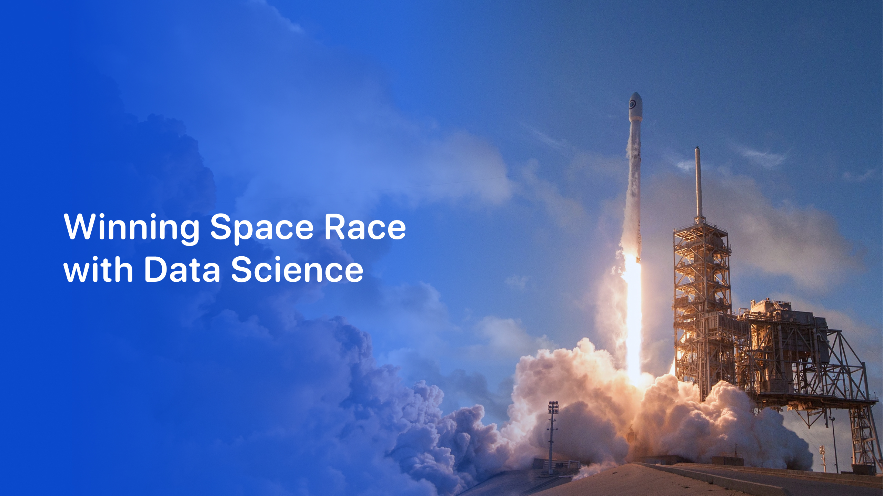

SpaceX Falcon 9 First Stage Landing Prediction
End-to-End Data Science & Machine Learning Capstone Report
Author: Heet Patel | IBM Data Science Professional Certificate
Date: October 2026 | Submission Format: PDF & Python/Jupyter Deliverables
GitHub Repository: https://github.com/Heet-116/SpaceX-Falcon9-Landing-Prediction

Slide 2

Project Overview & Foundations
• 1. Executive Summary: Core findings, pipeline summary, and commercial takeaways
• 2. Introduction & Background: Reusable rocketry economics and research questions
Methodologies & Technical Architecture
• 3. Data Collection & Wrangling: SpaceX REST API, Wikipedia scraping, and data cleaning
• 4. Exploratory Data Analysis: Data visualization (Matplotlib/Seaborn) and SQL querying (SQLite)
• 5. Interactive Analytics: Folium geospatial mapping and Plotly Dash dynamic web dashboard
• 6. Predictive Modeling: Classification algorithms, hyperparameter tuning, and model evaluation
Results, Conclusions & Appendix
• 7. Complete Results: Visualizations, SQL outputs, interactive maps, and ML confusion matrix
• 8. Conclusions & Business Impact: Competitive launch bidding and commercial strategy
• 9. Appendix: Data dictionary, technology stack, and verified GitHub repository code links
Project Overview & Foundations
• 1. Executive Summary: Core findings, pipeline summary, and commercial takeaways
• 2. Introduction & Background: Reusable rocketry economics and research questions
Methodologies & Technical Architecture
• 3. Data Collection & Wrangling: SpaceX REST API, Wikipedia scraping, and data cleaning
• 4. Exploratory Data Analysis: Data visualization (Matplotlib/Seaborn) and SQL querying (SQLite)
• 5. Interactive Analytics: Folium geospatial mapping and Plotly Dash dynamic web dashboard
• 6. Predictive Modeling: Classification algorithms, hyperparameter tuning, and model evaluation
Results, Conclusions & Appendix
• 7. Complete Results: Visualizations, SQL outputs, interactive maps, and ML confusion matrix
• 8. Conclusions & Business Impact: Competitive launch bidding and commercial strategy
• 9. Appendix: Data dictionary, technology stack, and verified GitHub repository code links
Project Overview & Foundations
• 1. Executive Summary: Core findings, pipeline summary, and commercial takeaways
• 2. Introduction & Background: Reusable rocketry economics and research questions
Methodologies & Technical Architecture
• 3. Data Collection & Wrangling: SpaceX REST API, Wikipedia scraping, and data cleaning
• 4. Exploratory Data Analysis: Data visualization (Matplotlib/Seaborn) and SQL querying (SQLite)
• 5. Interactive Analytics: Folium geospatial mapping and Plotly Dash dynamic web dashboard
• 6. Predictive Modeling: Classification algorithms, hyperparameter tuning, and model evaluation
Results, Conclusions & Appendix
• 7. Complete Results: Visualizations, SQL outputs, interactive maps, and ML confusion matrix
• 8. Conclusions & Business Impact: Competitive launch bidding and commercial strategy
• 9. Appendix: Data dictionary, technology stack, and verified GitHub repository code links

Slide 3
Summary of Methodologies
• Data Collection & Processing: Ingested 90 Falcon 9 launches via SpaceX REST API v4 and historical Wikipedia web scraping using BeautifulSoup. Cleaned null payload records with mean imputation (6,105 kg) and engineered a binary 'Class' landing target (1 = Success, 0 = Failure).
• Exploratory Data Analysis: Analyzed relationships between payload, orbit, flight number, and launch site; executed 10 structured SQL queries in SQLite to isolate operational milestones, payloads, and booster variants.
• Interactive Analytics: Built Folium maps with marker clusters and Haversine proximity calculations to coastal/transport infrastructure; engineered a responsive Plotly Dash dashboard with payload range sliders and site dropdowns.
• Machine Learning: Standardized 83 features via StandardScaler; trained 4 classification models (Logistic Regression, SVM, Decision Tree, KNN) optimized using 10-fold cross-validation GridSearchCV.
Summary of Key Results & Commercial Takeaways
• Overall Landing Success Rate: 66.7% across all 90 launches; success escalated from 0% (2010–2012) to >80% (2018–2020) driven by Falcon 9 Block 5 reusability advancements.
• Top Launch Site: KSC LC-39A achieved the highest success rate (76.9%) and contributed 41.7% of all successful first-stage recoveries.
• Predictive Accuracy: All 4 machine learning models achieved 83.33% Test Accuracy. The models delivered 100% Recall for successful landings (0 False Negatives), preventing premature disposal of recoverable boosters.
• Business Impact: Enables commercial satellite operators and competitor launch providers to predict SpaceX booster recovery with high confidence, informing competitive pricing against SpaceX's $62M launch rate.
Summary of Methodologies
• Data Collection & Processing: Ingested 90 Falcon 9 launches via SpaceX REST API v4 and historical Wikipedia web scraping using BeautifulSoup. Cleaned null payload records with mean imputation (6,105 kg) and engineered a binary 'Class' landing target (1 = Success, 0 = Failure).
• Exploratory Data Analysis: Analyzed relationships between payload, orbit, flight number, and launch site; executed 10 structured SQL queries in SQLite to isolate operational milestones, payloads, and booster variants.
• Interactive Analytics: Built Folium maps with marker clusters and Haversine proximity calculations to coastal/transport infrastructure; engineered a responsive Plotly Dash dashboard with payload range sliders and site dropdowns.
• Machine Learning: Standardized 83 features via StandardScaler; trained 4 classification models (Logistic Regression, SVM, Decision Tree, KNN) optimized using 10-fold cross-validation GridSearchCV.
Summary of Key Results & Commercial Takeaways
• Overall Landing Success Rate: 66.7% across all 90 launches; success escalated from 0% (2010–2012) to >80% (2018–2020) driven by Falcon 9 Block 5 reusability advancements.
• Top Launch Site: KSC LC-39A achieved the highest success rate (76.9%) and contributed 41.7% of all successful first-stage recoveries.
• Predictive Accuracy: All 4 machine learning models achieved 83.33% Test Accuracy. The models delivered 100% Recall for successful landings (0 False Negatives), preventing premature disposal of recoverable boosters.
• Business Impact: Enables commercial satellite operators and competitor launch providers to predict SpaceX booster recovery with high confidence, informing competitive pricing against SpaceX's $62M launch rate.
Summary of Methodologies
• Data Collection & Processing: Ingested 90 Falcon 9 launches via SpaceX REST API v4 and historical Wikipedia web scraping using BeautifulSoup. Cleaned null payload records with mean imputation (6,105 kg) and engineered a binary 'Class' landing target (1 = Success, 0 = Failure).
• Exploratory Data Analysis: Analyzed relationships between payload, orbit, flight number, and launch site; executed 10 structured SQL queries in SQLite to isolate operational milestones, payloads, and booster variants.
• Interactive Analytics: Built Folium maps with marker clusters and Haversine proximity calculations to coastal/transport infrastructure; engineered a responsive Plotly Dash dashboard with payload range sliders and site dropdowns.
• Machine Learning: Standardized 83 features via StandardScaler; trained 4 classification models (Logistic Regression, SVM, Decision Tree, KNN) optimized using 10-fold cross-validation GridSearchCV.
Summary of Key Results & Commercial Takeaways
• Overall Landing Success Rate: 66.7% across all 90 launches; success escalated from 0% (2010–2012) to >80% (2018–2020) driven by Falcon 9 Block 5 reusability advancements.
• Top Launch Site: KSC LC-39A achieved the highest success rate (76.9%) and contributed 41.7% of all successful first-stage recoveries.
• Predictive Accuracy: All 4 machine learning models achieved 83.33% Test Accuracy. The models delivered 100% Recall for successful landings (0 False Negatives), preventing premature disposal of recoverable boosters.
• Business Impact: Enables commercial satellite operators and competitor launch providers to predict SpaceX booster recovery with high confidence, informing competitive pricing against SpaceX's $62M launch rate.

Slide 4
Project Background & Commercial Context
• SpaceX Revolution: SpaceX has drastically reduced orbital launch costs by mastering first-stage booster recovery and reuse.
• Economic Asymmetry: Competitor launch providers (e.g., ULA, Arianespace, Roscosmos) operate expendable rockets costing upwards of $165M+ per launch, whereas SpaceX advertises Falcon 9 launches at approximately $62M.
• Value of Recovery: The first-stage booster represents ~70% of total rocket manufacturing cost. Reusing boosters multiple times amortizes production capital and yields unprecedented commercial margins.
Core Research Questions to Answer
• 1. Determinants of Recovery: How do payload mass, target orbital profile, launch site geography, and booster flight cadence influence landing success?
• 2. Geospatial Patterns: Why are launch complexes positioned along specific coastlines, and how do distances to transport and cities affect operational safety?
• 3. Machine Learning Viability: Can supervised classification models accurately forecast landing outcomes for future launches prior to liftoff?
• 4. Strategic Bidding Utility: How can competitor launch providers utilize these predictive models to formulate competitive bids against SpaceX contracts?
Project Background & Commercial Context
• SpaceX Revolution: SpaceX has drastically reduced orbital launch costs by mastering first-stage booster recovery and reuse.
• Economic Asymmetry: Competitor launch providers (e.g., ULA, Arianespace, Roscosmos) operate expendable rockets costing upwards of $165M+ per launch, whereas SpaceX advertises Falcon 9 launches at approximately $62M.
• Value of Recovery: The first-stage booster represents ~70% of total rocket manufacturing cost. Reusing boosters multiple times amortizes production capital and yields unprecedented commercial margins.
Core Research Questions to Answer
• 1. Determinants of Recovery: How do payload mass, target orbital profile, launch site geography, and booster flight cadence influence landing success?
• 2. Geospatial Patterns: Why are launch complexes positioned along specific coastlines, and how do distances to transport and cities affect operational safety?
• 3. Machine Learning Viability: Can supervised classification models accurately forecast landing outcomes for future launches prior to liftoff?
• 4. Strategic Bidding Utility: How can competitor launch providers utilize these predictive models to formulate competitive bids against SpaceX contracts?
Project Background & Commercial Context
• SpaceX Revolution: SpaceX has drastically reduced orbital launch costs by mastering first-stage booster recovery and reuse.
• Economic Asymmetry: Competitor launch providers (e.g., ULA, Arianespace, Roscosmos) operate expendable rockets costing upwards of $165M+ per launch, whereas SpaceX advertises Falcon 9 launches at approximately $62M.
• Value of Recovery: The first-stage booster represents ~70% of total rocket manufacturing cost. Reusing boosters multiple times amortizes production capital and yields unprecedented commercial margins.
Core Research Questions to Answer
• 1. Determinants of Recovery: How do payload mass, target orbital profile, launch site geography, and booster flight cadence influence landing success?
• 2. Geospatial Patterns: Why are launch complexes positioned along specific coastlines, and how do distances to transport and cities affect operational safety?
• 3. Machine Learning Viability: Can supervised classification models accurately forecast landing outcomes for future launches prior to liftoff?
• 4. Strategic Bidding Utility: How can competitor launch providers utilize these predictive models to formulate competitive bids against SpaceX contracts?

Slide 5

Section 1

Slide 6
Phase 1: Data Collection & Ingestion
• Extracted 90+ rocket launch records via SpaceX REST API v4 (JSON) capturing cores, flight numbers, payload specs, and landing pads.
• Scraped historical Falcon 9 launch logs from Wikipedia using BeautifulSoup to extract customers, dates, and mission outcomes.
Phase 2: Data Wrangling & Feature Engineering
• Identified missing payload values and imputed with mean (6,104.96 kg); mapped raw landing outcomes into binary classification target 'Class'.
• Applied one-hot encoding on categorical features (Orbit, LaunchSite, LandingPad, Serial), expanding the feature space to 83 numerical columns.
Phase 3: Exploratory Data Analysis & Relational Querying
• Executed visualization analysis across payload, orbit, and temporal trends using Matplotlib and Seaborn.
• Loaded datasets into SQLite database 'SPACEXTBL' and conducted 10 technical SQL queries for aggregated insights and historical milestones.
Phase 4: Interactive Visual Analytics
• Constructed Folium interactive maps with marker clusters and Haversine distance proximity measurements to coastline, transport, and cities.
• Engineered a dynamic Plotly Dash web dashboard featuring reactive dropdowns and payload range sliders for live slice-and-dice analytics.
Phase 5: Predictive Modeling & Hyperparameter Tuning
• Standardized features via StandardScaler; partitioned data into 80% Train and 20% Test sets (random_state=2).
• Tuned Logistic Regression, SVM, Decision Tree, and KNN models using GridSearchCV with 10-fold cross validation; evaluated test accuracy and confusion matrix.
Phase 1: Data Collection & Ingestion
• Extracted 90+ rocket launch records via SpaceX REST API v4 (JSON) capturing cores, flight numbers, payload specs, and landing pads.
• Scraped historical Falcon 9 launch logs from Wikipedia using BeautifulSoup to extract customers, dates, and mission outcomes.
Phase 2: Data Wrangling & Feature Engineering
• Identified missing payload values and imputed with mean (6,104.96 kg); mapped raw landing outcomes into binary classification target 'Class'.
• Applied one-hot encoding on categorical features (Orbit, LaunchSite, LandingPad, Serial), expanding the feature space to 83 numerical columns.
Phase 3: Exploratory Data Analysis & Relational Querying
• Executed visualization analysis across payload, orbit, and temporal trends using Matplotlib and Seaborn.
• Loaded datasets into SQLite database 'SPACEXTBL' and conducted 10 technical SQL queries for aggregated insights and historical milestones.
Phase 4: Interactive Visual Analytics
• Constructed Folium interactive maps with marker clusters and Haversine distance proximity measurements to coastline, transport, and cities.
• Engineered a dynamic Plotly Dash web dashboard featuring reactive dropdowns and payload range sliders for live slice-and-dice analytics.
Phase 5: Predictive Modeling & Hyperparameter Tuning
• Standardized features via StandardScaler; partitioned data into 80% Train and 20% Test sets (random_state=2).
• Tuned Logistic Regression, SVM, Decision Tree, and KNN models using GridSearchCV with 10-fold cross validation; evaluated test accuracy and confusion matrix.
Phase 1: Data Collection & Ingestion
• Extracted 90+ rocket launch records via SpaceX REST API v4 (JSON) capturing cores, flight numbers, payload specs, and landing pads.
• Scraped historical Falcon 9 launch logs from Wikipedia using BeautifulSoup to extract customers, dates, and mission outcomes.
Phase 2: Data Wrangling & Feature Engineering
• Identified missing payload values and imputed with mean (6,104.96 kg); mapped raw landing outcomes into binary classification target 'Class'.
• Applied one-hot encoding on categorical features (Orbit, LaunchSite, LandingPad, Serial), expanding the feature space to 83 numerical columns.
Phase 3: Exploratory Data Analysis & Relational Querying
• Executed visualization analysis across payload, orbit, and temporal trends using Matplotlib and Seaborn.
• Loaded datasets into SQLite database 'SPACEXTBL' and conducted 10 technical SQL queries for aggregated insights and historical milestones.
Phase 4: Interactive Visual Analytics
• Constructed Folium interactive maps with marker clusters and Haversine distance proximity measurements to coastline, transport, and cities.
• Engineered a dynamic Plotly Dash web dashboard featuring reactive dropdowns and payload range sliders for live slice-and-dice analytics.
Phase 5: Predictive Modeling & Hyperparameter Tuning
• Standardized features via StandardScaler; partitioned data into 80% Train and 20% Test sets (random_state=2).
• Tuned Logistic Regression, SVM, Decision Tree, and KNN models using GridSearchCV with 10-fold cross validation; evaluated test accuracy and confusion matrix.

Slide 7
Data Source 1: SpaceX REST API (JSON)
• Endpoint: https://api.spacexdata.com/v4/launches/past
• Extraction Method: Used Python 'requests' library to pull comprehensive raw launch data in JSON format.
• Data Structure: Utilized 'pd.json_normalize' to unnest JSON payloads, extracting rocket IDs, cores, payloads, flight numbers, and launchpads.
• Filtering: Filtered dataset strictly for Falcon 9 launches (excluding Falcon 1 test flights and Falcon Heavy 3-core configurations), yielding 90 launches.
Data Source 2: Wikipedia Web Scraping (HTML Tables)
• Target Page: 'List of Falcon 9 and Falcon Heavy launches' Wikipedia historical archive.
• Extraction Method: Applied BeautifulSoup to parse HTML document trees and navigate 'wikitable' table structures.
• Extracted Attributes: Extracted Flight Number, Launch Date, Booster Version, Launch Site, Payload Name, Payload Mass, Orbit Type, Customer, and Outcome.
• Data Sanitization: Stripped superscript citations (e.g. '[12]'), handled irregular dates, and standardized numeric payload masses.
Data Synthesis & Quality Assurance
• Cross-referenced API records with Wikipedia launch logs to ensure zero missing core serials and full alignment on mission outcomes.
• GitHub Notebook References: [1_SpaceX_Data_Collection_API.ipynb] & [2_SpaceX_Data_Collection_Web_Scraping.ipynb]
Data Source 1: SpaceX REST API (JSON)
• Endpoint: https://api.spacexdata.com/v4/launches/past
• Extraction Method: Used Python 'requests' library to pull comprehensive raw launch data in JSON format.
• Data Structure: Utilized 'pd.json_normalize' to unnest JSON payloads, extracting rocket IDs, cores, payloads, flight numbers, and launchpads.
• Filtering: Filtered dataset strictly for Falcon 9 launches (excluding Falcon 1 test flights and Falcon Heavy 3-core configurations), yielding 90 launches.
Data Source 2: Wikipedia Web Scraping (HTML Tables)
• Target Page: 'List of Falcon 9 and Falcon Heavy launches' Wikipedia historical archive.
• Extraction Method: Applied BeautifulSoup to parse HTML document trees and navigate 'wikitable' table structures.
• Extracted Attributes: Extracted Flight Number, Launch Date, Booster Version, Launch Site, Payload Name, Payload Mass, Orbit Type, Customer, and Outcome.
• Data Sanitization: Stripped superscript citations (e.g. '[12]'), handled irregular dates, and standardized numeric payload masses.
Data Synthesis & Quality Assurance
• Cross-referenced API records with Wikipedia launch logs to ensure zero missing core serials and full alignment on mission outcomes.
• GitHub Notebook References: [1_SpaceX_Data_Collection_API.ipynb] & [2_SpaceX_Data_Collection_Web_Scraping.ipynb]
Data Source 1: SpaceX REST API (JSON)
• Endpoint: https://api.spacexdata.com/v4/launches/past
• Extraction Method: Used Python 'requests' library to pull comprehensive raw launch data in JSON format.
• Data Structure: Utilized 'pd.json_normalize' to unnest JSON payloads, extracting rocket IDs, cores, payloads, flight numbers, and launchpads.
• Filtering: Filtered dataset strictly for Falcon 9 launches (excluding Falcon 1 test flights and Falcon Heavy 3-core configurations), yielding 90 launches.
Data Source 2: Wikipedia Web Scraping (HTML Tables)
• Target Page: 'List of Falcon 9 and Falcon Heavy launches' Wikipedia historical archive.
• Extraction Method: Applied BeautifulSoup to parse HTML document trees and navigate 'wikitable' table structures.
• Extracted Attributes: Extracted Flight Number, Launch Date, Booster Version, Launch Site, Payload Name, Payload Mass, Orbit Type, Customer, and Outcome.
• Data Sanitization: Stripped superscript citations (e.g. '[12]'), handled irregular dates, and standardized numeric payload masses.
Data Synthesis & Quality Assurance
• Cross-referenced API records with Wikipedia launch logs to ensure zero missing core serials and full alignment on mission outcomes.
• GitHub Notebook References: [1_SpaceX_Data_Collection_API.ipynb] & [2_SpaceX_Data_Collection_Web_Scraping.ipynb]

Slide 8
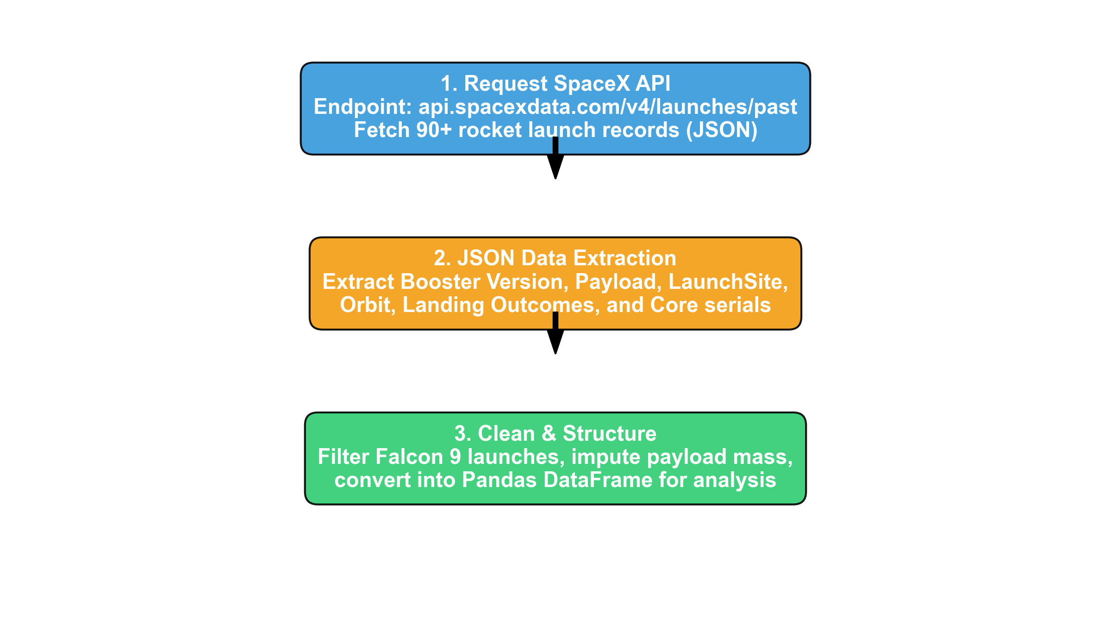
API Call Process & Telemetry Extraction
• Endpoint: api.spacexdata.com/v4/launches/past
• Payload Details: Retrieved payload masses, destination orbits, and customer IDs from child endpoints.
• Core Telemetry: Extracted booster serials, flight counts, gridfins status, landing leg deployment, landing pad IDs, and landing outcomes.
• Dataframe Construction: Consolidated unnested records into a structured Pandas DataFrame of 90 Falcon 9 missions with 17 features.
GitHub Notebook Reference
• Completed Notebook: notebooks/1_SpaceX_Data_Collection_API.ipynb
• URL: https://github.com/Heet-116/SpaceX-Falcon9-Landing-Prediction/blob/main/notebooks/1_SpaceX_Data_Collection_API.ipynb
API Call Process & Telemetry Extraction
• Endpoint: api.spacexdata.com/v4/launches/past
• Payload Details: Retrieved payload masses, destination orbits, and customer IDs from child endpoints.
• Core Telemetry: Extracted booster serials, flight counts, gridfins status, landing leg deployment, landing pad IDs, and landing outcomes.
• Dataframe Construction: Consolidated unnested records into a structured Pandas DataFrame of 90 Falcon 9 missions with 17 features.
GitHub Notebook Reference
• Completed Notebook: notebooks/1_SpaceX_Data_Collection_API.ipynb
• URL: https://github.com/Heet-116/SpaceX-Falcon9-Landing-Prediction/blob/main/notebooks/1_SpaceX_Data_Collection_API.ipynb
API Call Process & Telemetry Extraction
• Endpoint: api.spacexdata.com/v4/launches/past
• Payload Details: Retrieved payload masses, destination orbits, and customer IDs from child endpoints.
• Core Telemetry: Extracted booster serials, flight counts, gridfins status, landing leg deployment, landing pad IDs, and landing outcomes.
• Dataframe Construction: Consolidated unnested records into a structured Pandas DataFrame of 90 Falcon 9 missions with 17 features.
GitHub Notebook Reference
• Completed Notebook: notebooks/1_SpaceX_Data_Collection_API.ipynb
• URL: https://github.com/Heet-116/SpaceX-Falcon9-Landing-Prediction/blob/main/notebooks/1_SpaceX_Data_Collection_API.ipynb
API Call Process & Telemetry Extraction
• Endpoint: api.spacexdata.com/v4/launches/past
• Payload Details: Retrieved payload masses, destination orbits, and customer IDs from child endpoints.
• Core Telemetry: Extracted booster serials, flight counts, gridfins status, landing leg deployment, landing pad IDs, and landing outcomes.
• Dataframe Construction: Consolidated unnested records into a structured Pandas DataFrame of 90 Falcon 9 missions with 17 features.
GitHub Notebook Reference
• Completed Notebook: notebooks/1_SpaceX_Data_Collection_API.ipynb
• URL: https://github.com/Heet-116/SpaceX-Falcon9-Landing-Prediction/blob/main/notebooks/1_SpaceX_Data_Collection_API.ipynb

Slide 9
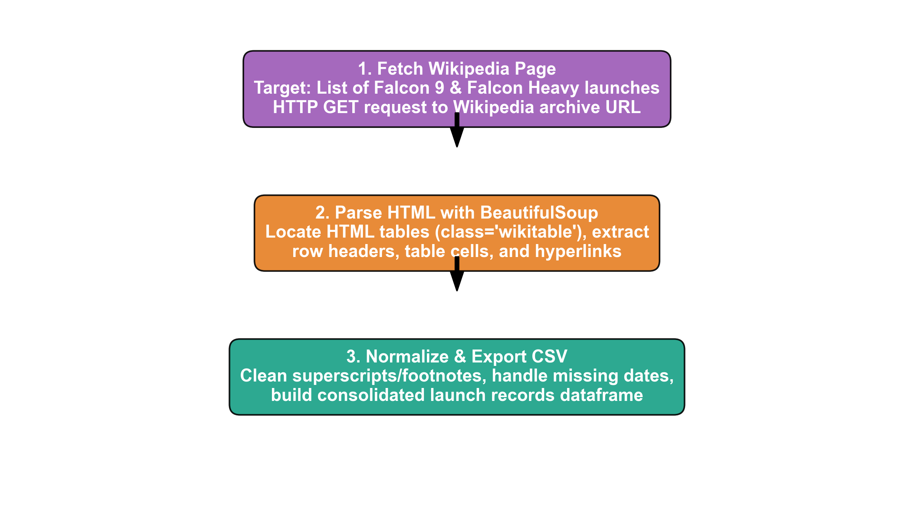
HTML Scraping Pipeline with BeautifulSoup
• Target URL: Wikipedia List of Falcon 9 launches
• HTML Parsing: Inspected DOM hierarchy; targeted table elements with class 'wikitable'.
• Table Traversal: Extracted column headers from <th> tags; iterated through <tr> rows and <td> cells.
• Cleaning Rules: Regex used to strip citation brackets ('[1]'), remove unicode whitespace, and cast payload masses to float.
• Output: Built a secondary reference DataFrame matching historical launch records.
GitHub Notebook Reference
• Completed Notebook: notebooks/2_SpaceX_Data_Collection_Web_Scraping.ipynb
• URL: https://github.com/Heet-116/SpaceX-Falcon9-Landing-Prediction/blob/main/notebooks/2_SpaceX_Data_Collection_Web_Scraping.ipynb
HTML Scraping Pipeline with BeautifulSoup
• Target URL: Wikipedia List of Falcon 9 launches
• HTML Parsing: Inspected DOM hierarchy; targeted table elements with class 'wikitable'.
• Table Traversal: Extracted column headers from <th> tags; iterated through <tr> rows and <td> cells.
• Cleaning Rules: Regex used to strip citation brackets ('[1]'), remove unicode whitespace, and cast payload masses to float.
• Output: Built a secondary reference DataFrame matching historical launch records.
GitHub Notebook Reference
• Completed Notebook: notebooks/2_SpaceX_Data_Collection_Web_Scraping.ipynb
• URL: https://github.com/Heet-116/SpaceX-Falcon9-Landing-Prediction/blob/main/notebooks/2_SpaceX_Data_Collection_Web_Scraping.ipynb
HTML Scraping Pipeline with BeautifulSoup
• Target URL: Wikipedia List of Falcon 9 launches
• HTML Parsing: Inspected DOM hierarchy; targeted table elements with class 'wikitable'.
• Table Traversal: Extracted column headers from <th> tags; iterated through <tr> rows and <td> cells.
• Cleaning Rules: Regex used to strip citation brackets ('[1]'), remove unicode whitespace, and cast payload masses to float.
• Output: Built a secondary reference DataFrame matching historical launch records.
GitHub Notebook Reference
• Completed Notebook: notebooks/2_SpaceX_Data_Collection_Web_Scraping.ipynb
• URL: https://github.com/Heet-116/SpaceX-Falcon9-Landing-Prediction/blob/main/notebooks/2_SpaceX_Data_Collection_Web_Scraping.ipynb
HTML Scraping Pipeline with BeautifulSoup
• Target URL: Wikipedia List of Falcon 9 launches
• HTML Parsing: Inspected DOM hierarchy; targeted table elements with class 'wikitable'.
• Table Traversal: Extracted column headers from <th> tags; iterated through <tr> rows and <td> cells.
• Cleaning Rules: Regex used to strip citation brackets ('[1]'), remove unicode whitespace, and cast payload masses to float.
• Output: Built a secondary reference DataFrame matching historical launch records.
GitHub Notebook Reference
• Completed Notebook: notebooks/2_SpaceX_Data_Collection_Web_Scraping.ipynb
• URL: https://github.com/Heet-116/SpaceX-Falcon9-Landing-Prediction/blob/main/notebooks/2_SpaceX_Data_Collection_Web_Scraping.ipynb
HTML Scraping Pipeline with BeautifulSoup
• Target URL: Wikipedia List of Falcon 9 launches
• HTML Parsing: Inspected DOM hierarchy; targeted table elements with class 'wikitable'.
• Table Traversal: Extracted column headers from <th> tags; iterated through <tr> rows and <td> cells.
• Cleaning Rules: Regex used to strip citation brackets ('[1]'), remove unicode whitespace, and cast payload masses to float.
• Output: Built a secondary reference DataFrame matching historical launch records.
GitHub Notebook Reference
• Completed Notebook: notebooks/2_SpaceX_Data_Collection_Web_Scraping.ipynb
• URL: https://github.com/Heet-116/SpaceX-Falcon9-Landing-Prediction/blob/main/notebooks/2_SpaceX_Data_Collection_Web_Scraping.ipynb

Slide 10
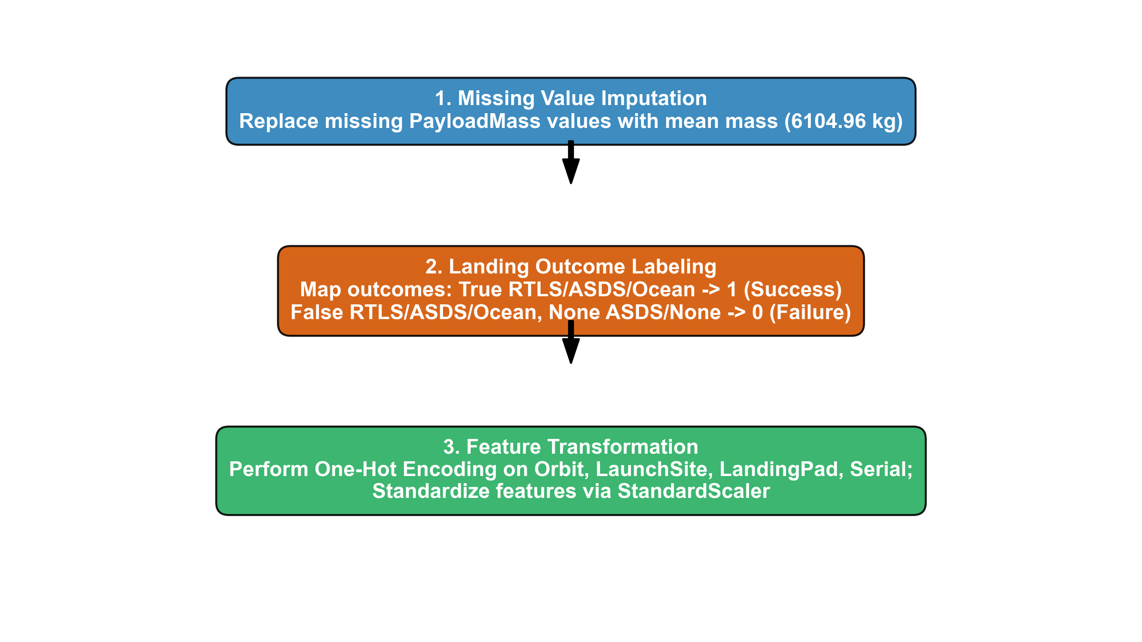
Data Cleaning & Target Encoding
• Handling Nulls: Identified 5 missing values in 'PayloadMass'; imputed with mean (6,104.96 kg) to maintain sample size.
• Outcome Categorization: Categorized landing outcomes: 'True RTLS', 'True ASDS', 'True Ocean' mapped to Class = 1 (Success); 'False RTLS/ASDS/Ocean' and 'None' mapped to Class = 0 (Failure).
• Target Balance: 60 Successful landings (66.7%), 30 Failed/Unattempted landings (33.3%).
• One-Hot Encoding: Converted categorical variables ('Orbit', 'LaunchSite', 'LandingPad', 'Serial') into 83 dummy columns using pd.get_dummies.
GitHub Notebook Reference
• Completed Notebook: notebooks/3_SpaceX_Data_Wrangling.ipynb
• URL: https://github.com/Heet-116/SpaceX-Falcon9-Landing-Prediction/blob/main/notebooks/3_SpaceX_Data_Wrangling.ipynb
Data Cleaning & Target Encoding
• Handling Nulls: Identified 5 missing values in 'PayloadMass'; imputed with mean (6,104.96 kg) to maintain sample size.
• Outcome Categorization: Categorized landing outcomes: 'True RTLS', 'True ASDS', 'True Ocean' mapped to Class = 1 (Success); 'False RTLS/ASDS/Ocean' and 'None' mapped to Class = 0 (Failure).
• Target Balance: 60 Successful landings (66.7%), 30 Failed/Unattempted landings (33.3%).
• One-Hot Encoding: Converted categorical variables ('Orbit', 'LaunchSite', 'LandingPad', 'Serial') into 83 dummy columns using pd.get_dummies.
GitHub Notebook Reference
• Completed Notebook: notebooks/3_SpaceX_Data_Wrangling.ipynb
• URL: https://github.com/Heet-116/SpaceX-Falcon9-Landing-Prediction/blob/main/notebooks/3_SpaceX_Data_Wrangling.ipynb
Data Cleaning & Target Encoding
• Handling Nulls: Identified 5 missing values in 'PayloadMass'; imputed with mean (6,104.96 kg) to maintain sample size.
• Outcome Categorization: Categorized landing outcomes: 'True RTLS', 'True ASDS', 'True Ocean' mapped to Class = 1 (Success); 'False RTLS/ASDS/Ocean' and 'None' mapped to Class = 0 (Failure).
• Target Balance: 60 Successful landings (66.7%), 30 Failed/Unattempted landings (33.3%).
• One-Hot Encoding: Converted categorical variables ('Orbit', 'LaunchSite', 'LandingPad', 'Serial') into 83 dummy columns using pd.get_dummies.
GitHub Notebook Reference
• Completed Notebook: notebooks/3_SpaceX_Data_Wrangling.ipynb
• URL: https://github.com/Heet-116/SpaceX-Falcon9-Landing-Prediction/blob/main/notebooks/3_SpaceX_Data_Wrangling.ipynb

Slide 11
Exploratory Data Visualization Pipeline
• Objective: Uncover hidden patterns, correlations, and success drivers across physical, geographic, and temporal flight variables.
• Tooling: Python Data Science Stack (Pandas, NumPy, Matplotlib, Seaborn).
• Key Visualizations Generated:
• 1. Flight Number vs. Launch Site: Scatter plot tracking site migration and operational maturity over time.
• 2. Payload Mass vs. Launch Site: Scatter plot assessing site-specific payload lift capacity and recovery success.
• 3. Success Rate vs. Orbit Type: Categorical bar chart quantifying risk levels across 11 distinct orbital profiles.
• 4. Flight Number vs. Orbit Type: Scatter plot mapping cadence growth from early LEO/GTO flights to high-volume VLEO constellations.
• 5. Payload Mass vs. Orbit Type: Scatter plot analyzing energy-payload boundaries and booster fuel recovery feasibility.
• 6. Yearly Success Trend: Temporal line chart tracing SpaceX's engineering learning curve from 2010 to 2020.
GitHub Notebook Reference
• Completed Notebook: notebooks/4_SpaceX_EDA_Data_Visualization.ipynb
• URL: https://github.com/Heet-116/SpaceX-Falcon9-Landing-Prediction/blob/main/notebooks/4_SpaceX_EDA_Data_Visualization.ipynb
Exploratory Data Visualization Pipeline
• Objective: Uncover hidden patterns, correlations, and success drivers across physical, geographic, and temporal flight variables.
• Tooling: Python Data Science Stack (Pandas, NumPy, Matplotlib, Seaborn).
• Key Visualizations Generated:
• 1. Flight Number vs. Launch Site: Scatter plot tracking site migration and operational maturity over time.
• 2. Payload Mass vs. Launch Site: Scatter plot assessing site-specific payload lift capacity and recovery success.
• 3. Success Rate vs. Orbit Type: Categorical bar chart quantifying risk levels across 11 distinct orbital profiles.
• 4. Flight Number vs. Orbit Type: Scatter plot mapping cadence growth from early LEO/GTO flights to high-volume VLEO constellations.
• 5. Payload Mass vs. Orbit Type: Scatter plot analyzing energy-payload boundaries and booster fuel recovery feasibility.
• 6. Yearly Success Trend: Temporal line chart tracing SpaceX's engineering learning curve from 2010 to 2020.
GitHub Notebook Reference
• Completed Notebook: notebooks/4_SpaceX_EDA_Data_Visualization.ipynb
• URL: https://github.com/Heet-116/SpaceX-Falcon9-Landing-Prediction/blob/main/notebooks/4_SpaceX_EDA_Data_Visualization.ipynb
Exploratory Data Visualization Pipeline
• Objective: Uncover hidden patterns, correlations, and success drivers across physical, geographic, and temporal flight variables.
• Tooling: Python Data Science Stack (Pandas, NumPy, Matplotlib, Seaborn).
• Key Visualizations Generated:
• 1. Flight Number vs. Launch Site: Scatter plot tracking site migration and operational maturity over time.
• 2. Payload Mass vs. Launch Site: Scatter plot assessing site-specific payload lift capacity and recovery success.
• 3. Success Rate vs. Orbit Type: Categorical bar chart quantifying risk levels across 11 distinct orbital profiles.
• 4. Flight Number vs. Orbit Type: Scatter plot mapping cadence growth from early LEO/GTO flights to high-volume VLEO constellations.
• 5. Payload Mass vs. Orbit Type: Scatter plot analyzing energy-payload boundaries and booster fuel recovery feasibility.
• 6. Yearly Success Trend: Temporal line chart tracing SpaceX's engineering learning curve from 2010 to 2020.
GitHub Notebook Reference
• Completed Notebook: notebooks/4_SpaceX_EDA_Data_Visualization.ipynb
• URL: https://github.com/Heet-116/SpaceX-Falcon9-Landing-Prediction/blob/main/notebooks/4_SpaceX_EDA_Data_Visualization.ipynb

Slide 12
Relational SQL Analysis Environment
• Database Engine: Loaded SpaceX historical launch dataset (101 records) into an SQLite database table named 'SPACEXTBL'.
• Querying Objectives: Conduct deterministic data profiling, historical milestone extraction, and customer payload auditing.
• Core SQL Capabilities Implemented:
• • Filtering & Pattern Matching: Applied LIKE 'CCA%' to isolate Cape Canaveral launches, and LIKE 'F9 v1.1%' to filter booster versions.
• • Mathematical Aggregations: Computed SUM(PAYLOAD_MASS__KG_) for NASA CRS contracts and AVG(PAYLOAD_MASS__KG_) across booster variants.
• • Chronological Extraction: Used MIN(Date) to pinpoint the exact date of the world's first successful orbital rocket landing.
• • Subqueries & Extrema: Formatted nested subqueries (WHERE PAYLOAD_MASS__KG_ = (SELECT MAX(...))) to identify heaviest liftoffs.
• • Frequency Ranking: Grouped outcomes by type, filtered date ranges using BETWEEN, and ordered by descending count.
GitHub Notebook Reference
• Completed Notebook: notebooks/5_SpaceX_EDA_SQL.ipynb
• URL: https://github.com/Heet-116/SpaceX-Falcon9-Landing-Prediction/blob/main/notebooks/5_SpaceX_EDA_SQL.ipynb
Relational SQL Analysis Environment
• Database Engine: Loaded SpaceX historical launch dataset (101 records) into an SQLite database table named 'SPACEXTBL'.
• Querying Objectives: Conduct deterministic data profiling, historical milestone extraction, and customer payload auditing.
• Core SQL Capabilities Implemented:
• • Filtering & Pattern Matching: Applied LIKE 'CCA%' to isolate Cape Canaveral launches, and LIKE 'F9 v1.1%' to filter booster versions.
• • Mathematical Aggregations: Computed SUM(PAYLOAD_MASS__KG_) for NASA CRS contracts and AVG(PAYLOAD_MASS__KG_) across booster variants.
• • Chronological Extraction: Used MIN(Date) to pinpoint the exact date of the world's first successful orbital rocket landing.
• • Subqueries & Extrema: Formatted nested subqueries (WHERE PAYLOAD_MASS__KG_ = (SELECT MAX(...))) to identify heaviest liftoffs.
• • Frequency Ranking: Grouped outcomes by type, filtered date ranges using BETWEEN, and ordered by descending count.
GitHub Notebook Reference
• Completed Notebook: notebooks/5_SpaceX_EDA_SQL.ipynb
• URL: https://github.com/Heet-116/SpaceX-Falcon9-Landing-Prediction/blob/main/notebooks/5_SpaceX_EDA_SQL.ipynb
Relational SQL Analysis Environment
• Database Engine: Loaded SpaceX historical launch dataset (101 records) into an SQLite database table named 'SPACEXTBL'.
• Querying Objectives: Conduct deterministic data profiling, historical milestone extraction, and customer payload auditing.
• Core SQL Capabilities Implemented:
• • Filtering & Pattern Matching: Applied LIKE 'CCA%' to isolate Cape Canaveral launches, and LIKE 'F9 v1.1%' to filter booster versions.
• • Mathematical Aggregations: Computed SUM(PAYLOAD_MASS__KG_) for NASA CRS contracts and AVG(PAYLOAD_MASS__KG_) across booster variants.
• • Chronological Extraction: Used MIN(Date) to pinpoint the exact date of the world's first successful orbital rocket landing.
• • Subqueries & Extrema: Formatted nested subqueries (WHERE PAYLOAD_MASS__KG_ = (SELECT MAX(...))) to identify heaviest liftoffs.
• • Frequency Ranking: Grouped outcomes by type, filtered date ranges using BETWEEN, and ordered by descending count.
GitHub Notebook Reference
• Completed Notebook: notebooks/5_SpaceX_EDA_SQL.ipynb
• URL: https://github.com/Heet-116/SpaceX-Falcon9-Landing-Prediction/blob/main/notebooks/5_SpaceX_EDA_SQL.ipynb

Slide 13
Folium Geospatial Mapping Architecture
• Geographic Engine: Utilized Python 'folium' library to render dynamic Leaflet.js interactive maps centered on US launch complexes.
• Marker Architecture: Generated 'folium.Marker' and 'folium.Circle' objects for CCAFS LC-40, CCAFS SLC-40, KSC LC-39A, and VAFB SLC-4E.
• Marker Clustering Plugin: Implemented 'folium.plugins.MarkerCluster' to aggregate dense launch markers, preventing visual clutter.
• Color-Coded Telemetry: Created custom icon markers color-coded by landing outcome (Green = Landing Success, Red = Landing Failure).
• Proximity & Distance Calculations: Implemented the Haversine spherical trigonometric formula to calculate exact straight-line distances from launch pads to coastlines, railways, highways, and nearest cities, overlaying dashed 'folium.PolyLine' visualizers.
GitHub Notebook Reference
• Completed Notebook: notebooks/6_SpaceX_Interactive_Visual_Analytics_Folium.ipynb
• URL: https://github.com/Heet-116/SpaceX-Falcon9-Landing-Prediction/blob/main/notebooks/6_SpaceX_Interactive_Visual_Analytics_Folium.ipynb
Folium Geospatial Mapping Architecture
• Geographic Engine: Utilized Python 'folium' library to render dynamic Leaflet.js interactive maps centered on US launch complexes.
• Marker Architecture: Generated 'folium.Marker' and 'folium.Circle' objects for CCAFS LC-40, CCAFS SLC-40, KSC LC-39A, and VAFB SLC-4E.
• Marker Clustering Plugin: Implemented 'folium.plugins.MarkerCluster' to aggregate dense launch markers, preventing visual clutter.
• Color-Coded Telemetry: Created custom icon markers color-coded by landing outcome (Green = Landing Success, Red = Landing Failure).
• Proximity & Distance Calculations: Implemented the Haversine spherical trigonometric formula to calculate exact straight-line distances from launch pads to coastlines, railways, highways, and nearest cities, overlaying dashed 'folium.PolyLine' visualizers.
GitHub Notebook Reference
• Completed Notebook: notebooks/6_SpaceX_Interactive_Visual_Analytics_Folium.ipynb
• URL: https://github.com/Heet-116/SpaceX-Falcon9-Landing-Prediction/blob/main/notebooks/6_SpaceX_Interactive_Visual_Analytics_Folium.ipynb
Folium Geospatial Mapping Architecture
• Geographic Engine: Utilized Python 'folium' library to render dynamic Leaflet.js interactive maps centered on US launch complexes.
• Marker Architecture: Generated 'folium.Marker' and 'folium.Circle' objects for CCAFS LC-40, CCAFS SLC-40, KSC LC-39A, and VAFB SLC-4E.
• Marker Clustering Plugin: Implemented 'folium.plugins.MarkerCluster' to aggregate dense launch markers, preventing visual clutter.
• Color-Coded Telemetry: Created custom icon markers color-coded by landing outcome (Green = Landing Success, Red = Landing Failure).
• Proximity & Distance Calculations: Implemented the Haversine spherical trigonometric formula to calculate exact straight-line distances from launch pads to coastlines, railways, highways, and nearest cities, overlaying dashed 'folium.PolyLine' visualizers.
GitHub Notebook Reference
• Completed Notebook: notebooks/6_SpaceX_Interactive_Visual_Analytics_Folium.ipynb
• URL: https://github.com/Heet-116/SpaceX-Falcon9-Landing-Prediction/blob/main/notebooks/6_SpaceX_Interactive_Visual_Analytics_Folium.ipynb

Slide 14
Plotly Dash Web Application Architecture
• Dashboard Framework: Built a multi-component reactive web application using Dash, dash_core_components (dcc), and dash_html_components (html).
• Interactive UI Controls:
• • Dropdown Component (dcc.Dropdown): Allows user to select 'All Sites' or toggle individual launch sites (CCAFS LC-40, VAFB SLC-4E, KSC LC-39A, CCAFS SLC-40).
• • Range Slider Component (dcc.RangeSlider): Enables fluid filtering across the entire payload spectrum (0 to 10,000 kg with 1,000 kg intervals).
• Reactive Callback Logic (@app.callback):
• • Callback 1: Generates dynamic 'px.pie' charts displaying total success proportion across all sites, or success vs. failure ratio for a selected site.
• • Callback 2: Dynamically renders 'px.scatter' plots of Payload Mass vs. Launch Outcome, color-coded by Booster Version Category.
GitHub Script Reference
• Completed Application Script: spacex_dash_app.py
• URL: https://github.com/Heet-116/SpaceX-Falcon9-Landing-Prediction/blob/main/spacex_dash_app.py
Plotly Dash Web Application Architecture
• Dashboard Framework: Built a multi-component reactive web application using Dash, dash_core_components (dcc), and dash_html_components (html).
• Interactive UI Controls:
• • Dropdown Component (dcc.Dropdown): Allows user to select 'All Sites' or toggle individual launch sites (CCAFS LC-40, VAFB SLC-4E, KSC LC-39A, CCAFS SLC-40).
• • Range Slider Component (dcc.RangeSlider): Enables fluid filtering across the entire payload spectrum (0 to 10,000 kg with 1,000 kg intervals).
• Reactive Callback Logic (@app.callback):
• • Callback 1: Generates dynamic 'px.pie' charts displaying total success proportion across all sites, or success vs. failure ratio for a selected site.
• • Callback 2: Dynamically renders 'px.scatter' plots of Payload Mass vs. Launch Outcome, color-coded by Booster Version Category.
GitHub Script Reference
• Completed Application Script: spacex_dash_app.py
• URL: https://github.com/Heet-116/SpaceX-Falcon9-Landing-Prediction/blob/main/spacex_dash_app.py
Plotly Dash Web Application Architecture
• Dashboard Framework: Built a multi-component reactive web application using Dash, dash_core_components (dcc), and dash_html_components (html).
• Interactive UI Controls:
• • Dropdown Component (dcc.Dropdown): Allows user to select 'All Sites' or toggle individual launch sites (CCAFS LC-40, VAFB SLC-4E, KSC LC-39A, CCAFS SLC-40).
• • Range Slider Component (dcc.RangeSlider): Enables fluid filtering across the entire payload spectrum (0 to 10,000 kg with 1,000 kg intervals).
• Reactive Callback Logic (@app.callback):
• • Callback 1: Generates dynamic 'px.pie' charts displaying total success proportion across all sites, or success vs. failure ratio for a selected site.
• • Callback 2: Dynamically renders 'px.scatter' plots of Payload Mass vs. Launch Outcome, color-coded by Booster Version Category.
GitHub Script Reference
• Completed Application Script: spacex_dash_app.py
• URL: https://github.com/Heet-116/SpaceX-Falcon9-Landing-Prediction/blob/main/spacex_dash_app.py

Slide 15
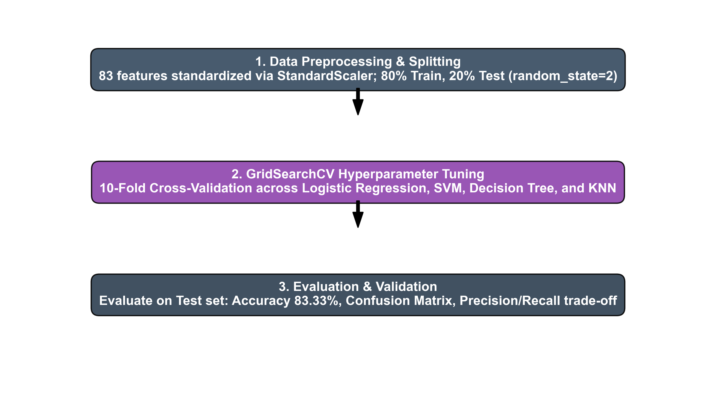
Machine Learning Development Pipeline
• Feature Standardization: Standardized 83 numerical features using Scikit-Learn 'StandardScaler' (zero mean, unit variance).
• Data Partitioning: Split into 80% Training (72 samples) and 20% Testing (18 samples) with random_state=2.
• Hyperparameter Tuning: Tuned 4 classifiers via GridSearchCV with 10-fold cross validation (cv=10):
• • Logistic Regression: L2 penalty, lbfgs solver, C in [0.01, 0.1, 1].
• • Support Vector Machine: Linear, RBF, Poly, Sigmoid kernels; C & gamma grids.
• • Decision Tree: Gini & entropy criteria; max_depth 2 to 18; min_samples_leaf.
• • K-Nearest Neighbors: k from 1 to 10; Euclidean and Manhattan distance metrics.
• Evaluation: Measured test set accuracy, confusion matrices, precision, and recall.
GitHub Notebook Reference
• Completed Notebook: notebooks/7_SpaceX_Machine_Learning_Prediction.ipynb
• URL: https://github.com/Heet-116/SpaceX-Falcon9-Landing-Prediction/blob/main/notebooks/7_SpaceX_Machine_Learning_Prediction.ipynb
Machine Learning Development Pipeline
• Feature Standardization: Standardized 83 numerical features using Scikit-Learn 'StandardScaler' (zero mean, unit variance).
• Data Partitioning: Split into 80% Training (72 samples) and 20% Testing (18 samples) with random_state=2.
• Hyperparameter Tuning: Tuned 4 classifiers via GridSearchCV with 10-fold cross validation (cv=10):
• • Logistic Regression: L2 penalty, lbfgs solver, C in [0.01, 0.1, 1].
• • Support Vector Machine: Linear, RBF, Poly, Sigmoid kernels; C & gamma grids.
• • Decision Tree: Gini & entropy criteria; max_depth 2 to 18; min_samples_leaf.
• • K-Nearest Neighbors: k from 1 to 10; Euclidean and Manhattan distance metrics.
• Evaluation: Measured test set accuracy, confusion matrices, precision, and recall.
GitHub Notebook Reference
• Completed Notebook: notebooks/7_SpaceX_Machine_Learning_Prediction.ipynb
• URL: https://github.com/Heet-116/SpaceX-Falcon9-Landing-Prediction/blob/main/notebooks/7_SpaceX_Machine_Learning_Prediction.ipynb
Machine Learning Development Pipeline
• Feature Standardization: Standardized 83 numerical features using Scikit-Learn 'StandardScaler' (zero mean, unit variance).
• Data Partitioning: Split into 80% Training (72 samples) and 20% Testing (18 samples) with random_state=2.
• Hyperparameter Tuning: Tuned 4 classifiers via GridSearchCV with 10-fold cross validation (cv=10):
• • Logistic Regression: L2 penalty, lbfgs solver, C in [0.01, 0.1, 1].
• • Support Vector Machine: Linear, RBF, Poly, Sigmoid kernels; C & gamma grids.
• • Decision Tree: Gini & entropy criteria; max_depth 2 to 18; min_samples_leaf.
• • K-Nearest Neighbors: k from 1 to 10; Euclidean and Manhattan distance metrics.
• Evaluation: Measured test set accuracy, confusion matrices, precision, and recall.
GitHub Notebook Reference
• Completed Notebook: notebooks/7_SpaceX_Machine_Learning_Prediction.ipynb
• URL: https://github.com/Heet-116/SpaceX-Falcon9-Landing-Prediction/blob/main/notebooks/7_SpaceX_Machine_Learning_Prediction.ipynb

Slide 16
Results
Exploratory data analysis results
Interactive analytics demo in screenshots
Predictive analysis results

Slide 17

Section 2

Slide 18
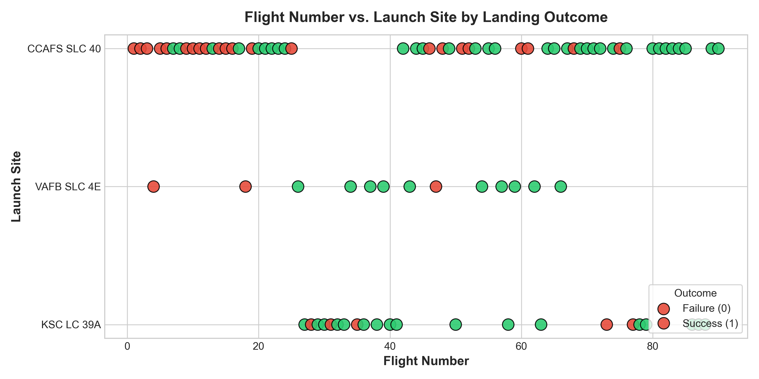
Key Observations & Flight Cadence
• Site Progression: Flights 1 through ~25 were launched almost exclusively from CCAFS LC-40, reflecting the initial experimental phase of Falcon 9.
• Landing Failure Clustering: Most early landing failures (red points) occurred at CCAFS LC-40 during early recovery development (2010–2015).
• Operational Maturity: Flights beyond #30 diversified to VAFB SLC-4E and KSC LC-39A, showing a dramatic concentration of green landing successes.
• Modern Reliability: For flight numbers >50, landing success rate exceeded 80% across all launch sites.
Key Observations & Flight Cadence
• Site Progression: Flights 1 through ~25 were launched almost exclusively from CCAFS LC-40, reflecting the initial experimental phase of Falcon 9.
• Landing Failure Clustering: Most early landing failures (red points) occurred at CCAFS LC-40 during early recovery development (2010–2015).
• Operational Maturity: Flights beyond #30 diversified to VAFB SLC-4E and KSC LC-39A, showing a dramatic concentration of green landing successes.
• Modern Reliability: For flight numbers >50, landing success rate exceeded 80% across all launch sites.
Key Observations & Flight Cadence
• Site Progression: Flights 1 through ~25 were launched almost exclusively from CCAFS LC-40, reflecting the initial experimental phase of Falcon 9.
• Landing Failure Clustering: Most early landing failures (red points) occurred at CCAFS LC-40 during early recovery development (2010–2015).
• Operational Maturity: Flights beyond #30 diversified to VAFB SLC-4E and KSC LC-39A, showing a dramatic concentration of green landing successes.
• Modern Reliability: For flight numbers >50, landing success rate exceeded 80% across all launch sites.

Slide 19
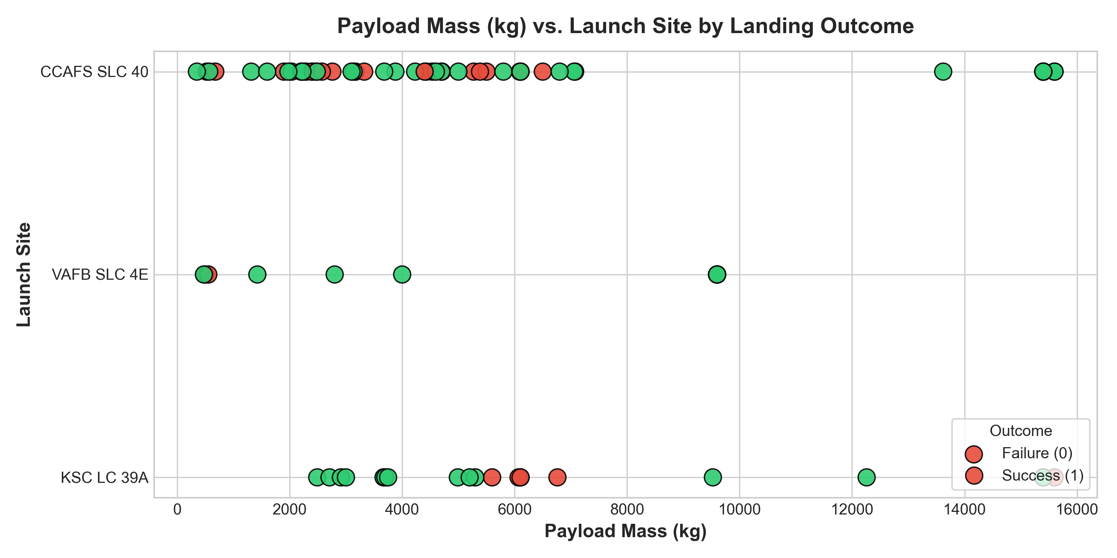
Key Observations & Payload Distribution
• VAFB SLC-4E Profile: Specialized in lighter to medium payload missions (<10,000 kg) dedicated to polar and sun-synchronous orbits, achieving consistent landing success.
• KSC LC-39A Dominance: Handled both medium and heavy payloads (>10,000 kg), including commercial communications satellites and ISS Dragon resupply, with an outstanding recovery record.
• CCAFS SLC-40 Range: Dispersed across the full payload spectrum (0 to 15,600 kg); early low-mass flights had mixed results, while modern heavy missions achieved consistent recovery.
Key Observations & Payload Distribution
• VAFB SLC-4E Profile: Specialized in lighter to medium payload missions (<10,000 kg) dedicated to polar and sun-synchronous orbits, achieving consistent landing success.
• KSC LC-39A Dominance: Handled both medium and heavy payloads (>10,000 kg), including commercial communications satellites and ISS Dragon resupply, with an outstanding recovery record.
• CCAFS SLC-40 Range: Dispersed across the full payload spectrum (0 to 15,600 kg); early low-mass flights had mixed results, while modern heavy missions achieved consistent recovery.
Key Observations & Payload Distribution
• VAFB SLC-4E Profile: Specialized in lighter to medium payload missions (<10,000 kg) dedicated to polar and sun-synchronous orbits, achieving consistent landing success.
• KSC LC-39A Dominance: Handled both medium and heavy payloads (>10,000 kg), including commercial communications satellites and ISS Dragon resupply, with an outstanding recovery record.
• CCAFS SLC-40 Range: Dispersed across the full payload spectrum (0 to 15,600 kg); early low-mass flights had mixed results, while modern heavy missions achieved consistent recovery.

Slide 20
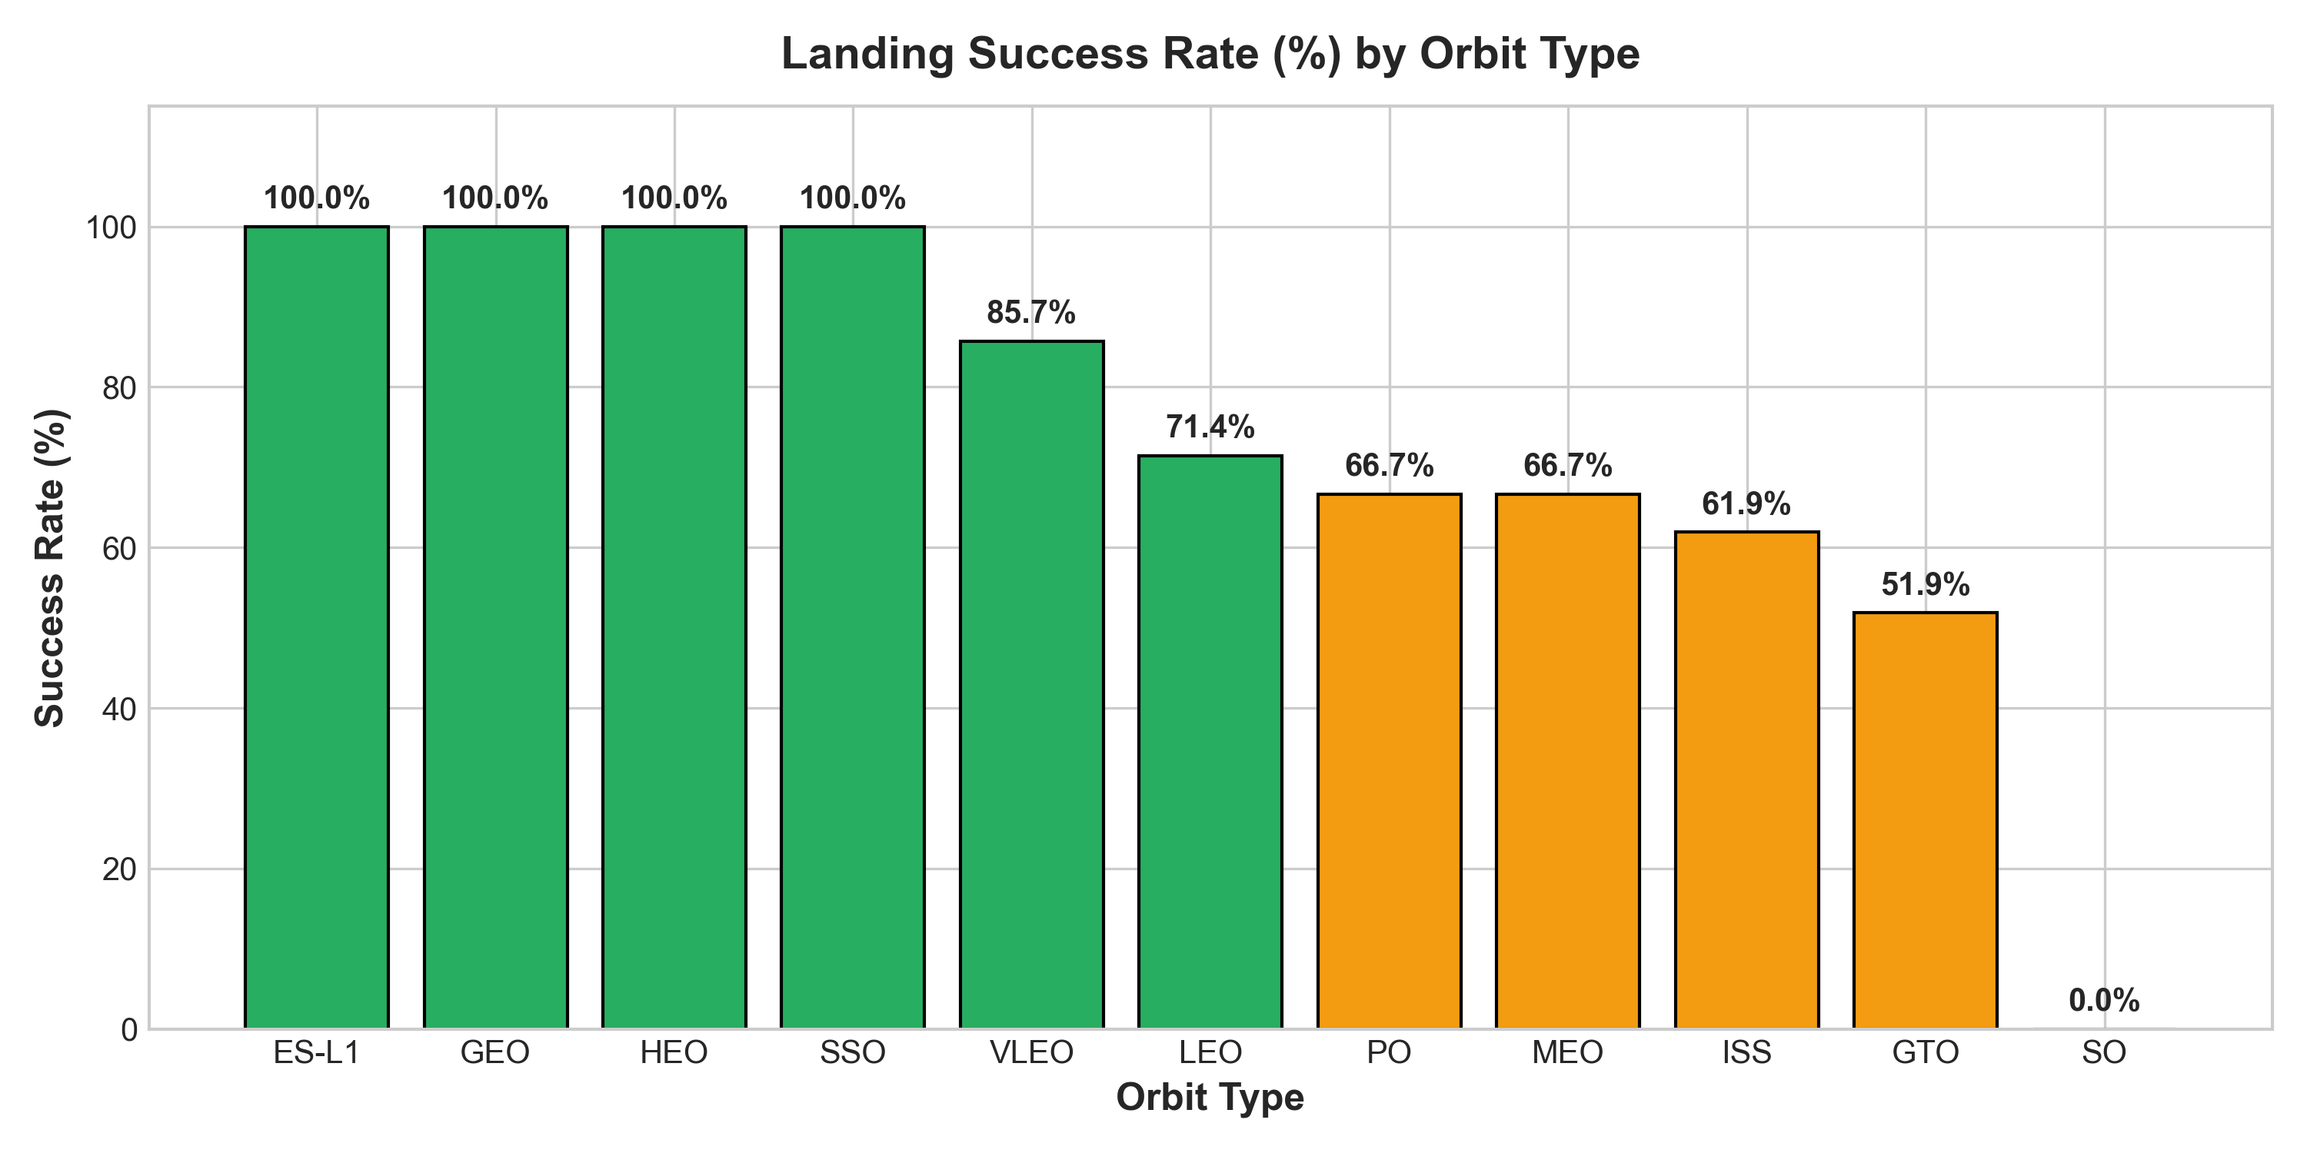
Key Observations by Orbital Trajectory
• 100% Success Orbits: ES-L1 (Earth-Sun Lagrange), GEO (Geosynchronous), HEO (Highly Elliptical), and SSO (Sun-Synchronous) all achieved a flawless 100% landing success rate.
• VLEO Constellations: Very Low Earth Orbit (Starlink) achieved ~85% success across high flight frequencies.
• LEO & Polar Orbits: LEO achieved ~71% and Polar Orbits (PO) achieved ~67% success rate.
• GTO Challenges: Geostationary Transfer Orbit achieved ~50% success due to extreme downrange velocity and severe thermal stress during atmospheric entry.
• SO Anomalies: Sub-Orbital test flight experienced 0% landing success.
Key Observations by Orbital Trajectory
• 100% Success Orbits: ES-L1 (Earth-Sun Lagrange), GEO (Geosynchronous), HEO (Highly Elliptical), and SSO (Sun-Synchronous) all achieved a flawless 100% landing success rate.
• VLEO Constellations: Very Low Earth Orbit (Starlink) achieved ~85% success across high flight frequencies.
• LEO & Polar Orbits: LEO achieved ~71% and Polar Orbits (PO) achieved ~67% success rate.
• GTO Challenges: Geostationary Transfer Orbit achieved ~50% success due to extreme downrange velocity and severe thermal stress during atmospheric entry.
• SO Anomalies: Sub-Orbital test flight experienced 0% landing success.
Key Observations by Orbital Trajectory
• 100% Success Orbits: ES-L1 (Earth-Sun Lagrange), GEO (Geosynchronous), HEO (Highly Elliptical), and SSO (Sun-Synchronous) all achieved a flawless 100% landing success rate.
• VLEO Constellations: Very Low Earth Orbit (Starlink) achieved ~85% success across high flight frequencies.
• LEO & Polar Orbits: LEO achieved ~71% and Polar Orbits (PO) achieved ~67% success rate.
• GTO Challenges: Geostationary Transfer Orbit achieved ~50% success due to extreme downrange velocity and severe thermal stress during atmospheric entry.
• SO Anomalies: Sub-Orbital test flight experienced 0% landing success.

Slide 21
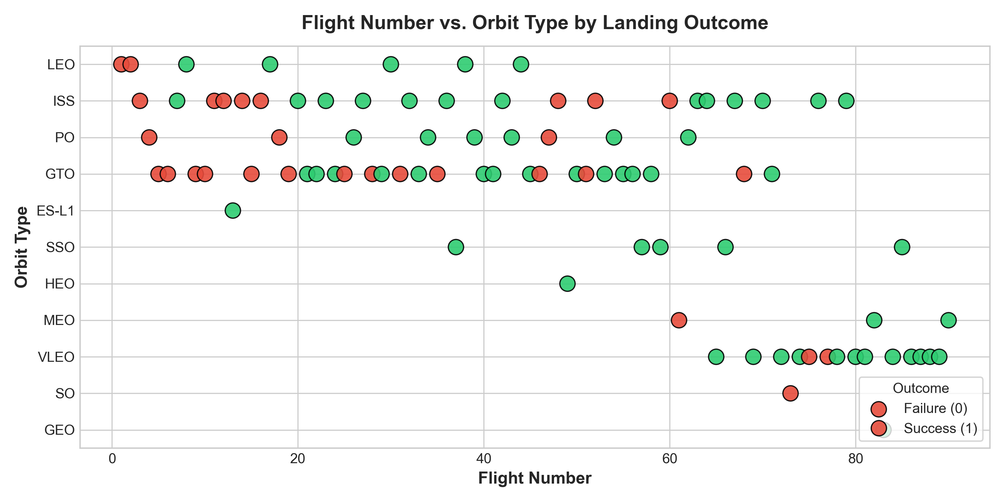
Key Observations & Mission Evolution
• Early Orbits: Early flight numbers (<30) primarily targeted LEO and GTO orbits with experimental landing profiles.
• Constellation Ramp-Up: Beyond Flight 50, mission frequency shifted dramatically toward VLEO (Starlink satellite mega-constellation deployment).
• Recovery Consistency: While early LEO and GTO missions experienced landing failures, later flights across all orbit types show nearly unbroken runs of green landing successes.
Key Observations & Mission Evolution
• Early Orbits: Early flight numbers (<30) primarily targeted LEO and GTO orbits with experimental landing profiles.
• Constellation Ramp-Up: Beyond Flight 50, mission frequency shifted dramatically toward VLEO (Starlink satellite mega-constellation deployment).
• Recovery Consistency: While early LEO and GTO missions experienced landing failures, later flights across all orbit types show nearly unbroken runs of green landing successes.
Key Observations & Mission Evolution
• Early Orbits: Early flight numbers (<30) primarily targeted LEO and GTO orbits with experimental landing profiles.
• Constellation Ramp-Up: Beyond Flight 50, mission frequency shifted dramatically toward VLEO (Starlink satellite mega-constellation deployment).
• Recovery Consistency: While early LEO and GTO missions experienced landing failures, later flights across all orbit types show nearly unbroken runs of green landing successes.

Slide 22
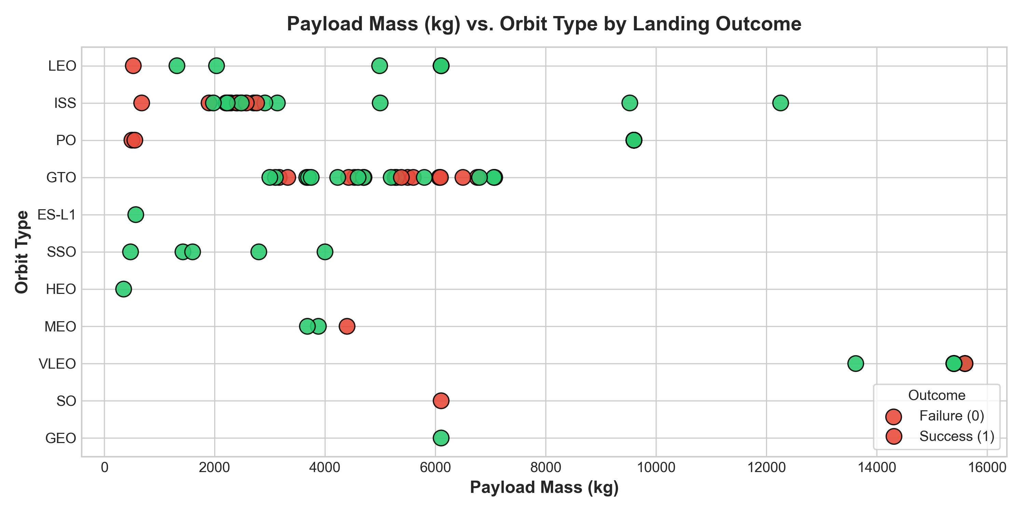
Key Observations & Orbital Payload Limits
• Heavy LEO/VLEO Missions: Maximum payload masses (>10,000 kg up to 15,600 kg) are concentrated in LEO and VLEO orbits, where landing success is consistently high.
• GTO Payload Constraint: GTO missions cluster in the 3,000 kg to 7,000 kg range. Heavy GTO launches leave less reserve fuel for the first-stage boostback and entry burns.
• Polar & Scientific Missions: Polar and SSO missions carried payloads under 4,000 kg, allowing comfortable fuel margins for booster recovery.
Key Observations & Orbital Payload Limits
• Heavy LEO/VLEO Missions: Maximum payload masses (>10,000 kg up to 15,600 kg) are concentrated in LEO and VLEO orbits, where landing success is consistently high.
• GTO Payload Constraint: GTO missions cluster in the 3,000 kg to 7,000 kg range. Heavy GTO launches leave less reserve fuel for the first-stage boostback and entry burns.
• Polar & Scientific Missions: Polar and SSO missions carried payloads under 4,000 kg, allowing comfortable fuel margins for booster recovery.
Key Observations & Orbital Payload Limits
• Heavy LEO/VLEO Missions: Maximum payload masses (>10,000 kg up to 15,600 kg) are concentrated in LEO and VLEO orbits, where landing success is consistently high.
• GTO Payload Constraint: GTO missions cluster in the 3,000 kg to 7,000 kg range. Heavy GTO launches leave less reserve fuel for the first-stage boostback and entry burns.
• Polar & Scientific Missions: Polar and SSO missions carried payloads under 4,000 kg, allowing comfortable fuel margins for booster recovery.

Slide 23
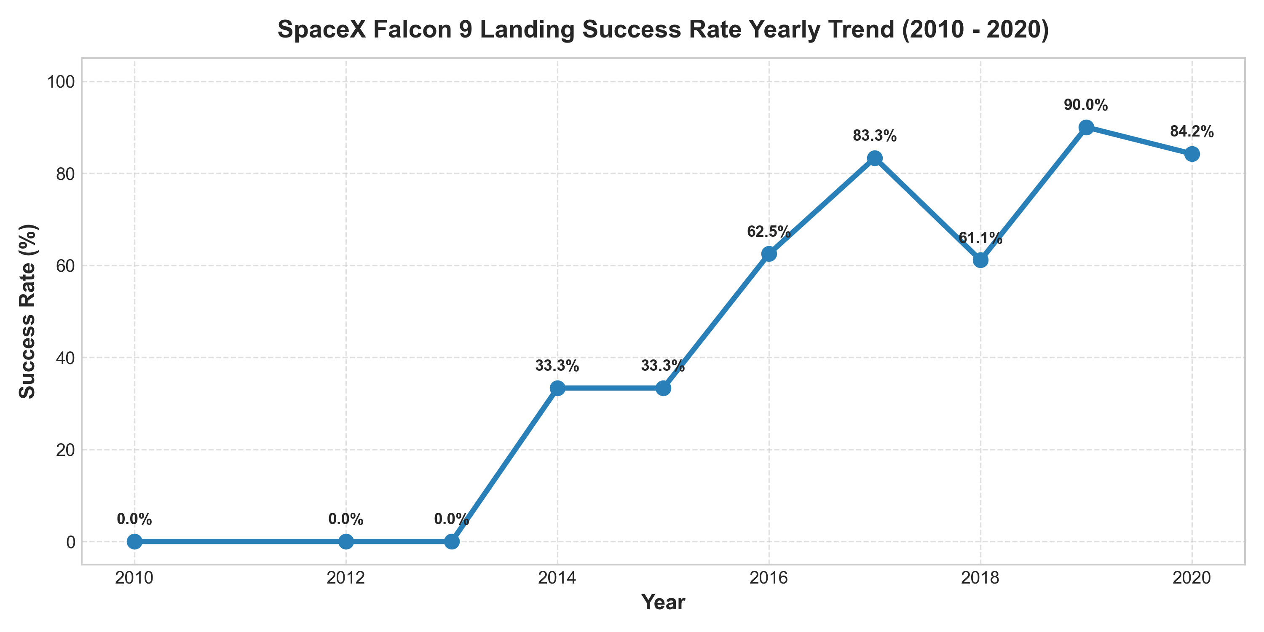
Key Observations & Technology Evolution
• 2010–2012 (0% Success): Purely expendable test launches; no booster recovery hardware existed.
• 2013–2015 (~33% Success): Controlled ocean splashdowns and drone ship tests began; historic first ground pad recovery on Dec 22, 2015.
• 2016–2017 (60–80% Success): Routine drone ship recoveries established on Autonomous Spaceport Drone Ships (ASDS).
• 2018–2020 (>80–85% Success): Introduction of Falcon 9 Block 5 (strengthened heat shield, titanium grid fins, upgraded engines) established industrial recovery reliability.
Key Observations & Technology Evolution
• 2010–2012 (0% Success): Purely expendable test launches; no booster recovery hardware existed.
• 2013–2015 (~33% Success): Controlled ocean splashdowns and drone ship tests began; historic first ground pad recovery on Dec 22, 2015.
• 2016–2017 (60–80% Success): Routine drone ship recoveries established on Autonomous Spaceport Drone Ships (ASDS).
• 2018–2020 (>80–85% Success): Introduction of Falcon 9 Block 5 (strengthened heat shield, titanium grid fins, upgraded engines) established industrial recovery reliability.
Key Observations & Technology Evolution
• 2010–2012 (0% Success): Purely expendable test launches; no booster recovery hardware existed.
• 2013–2015 (~33% Success): Controlled ocean splashdowns and drone ship tests began; historic first ground pad recovery on Dec 22, 2015.
• 2016–2017 (60–80% Success): Routine drone ship recoveries established on Autonomous Spaceport Drone Ships (ASDS).
• 2018–2020 (>80–85% Success): Introduction of Falcon 9 Block 5 (strengthened heat shield, titanium grid fins, upgraded engines) established industrial recovery reliability.

Slide 24
All Launch Site Names
SQL Query Syntax:
SELECT DISTINCT Launch_Site FROM SPACEXTBL
Launch_Site
CCAFS LC-40
VAFB SLC-4E
KSC LC-39A
CCAFS SLC-40
Key Analytical & Business Insight:
• The dataset contains 4 distinct launch sites. CCAFS LC-40 and KSC LC-39A serve East Coast launches into equatorial and high-inclination orbits, while VAFB SLC-4E serves West Coast launches into polar orbits.
Heet Patel | IBM Applied Data Science Capstone | https://github.com/Heet-116/SpaceX-Falcon9-Landing-Prediction

Slide 25
Launch Site Names Begin with 'CCA'
SQL Query Syntax:
SELECT Date, Booster_Version, Launch_Site, PAYLOAD_MASS__KG_, Landing_Outcome FROM SPACEXTBL WHERE Launch_Site LIKE 'CCA%' LIMIT 5
Date | Booster_Version | Launch_Site | PAYLOAD_MASS__KG_ | Landing_Outcome
2010-06-04 | F9 v1.0 B0003 | CCAFS LC-40 | 0 | Failure (parachute)
2010-12-08 | F9 v1.0 B0004 | CCAFS LC-40 | 0 | Failure (parachute)
2012-05-22 | F9 v1.0 B0005 | CCAFS LC-40 | 525 | No attempt
2012-10-08 | F9 v1.0 B0006 | CCAFS LC-40 | 500 | No attempt
2013-03-01 | F9 v1.0 B0007 | CCAFS LC-40 | 677 | No attempt
Key Analytical & Business Insight:
• The first 5 orbital flights were conducted from Cape Canaveral Air Force Station (CCAFS LC-40) carrying experimental Dragon qualification payloads with ocean splashdown landing attempts.
Heet Patel | IBM Applied Data Science Capstone | https://github.com/Heet-116/SpaceX-Falcon9-Landing-Prediction

Slide 26
Total Payload Mass
SQL Query Syntax:
SELECT SUM(PAYLOAD_MASS__KG_) AS Total_Payload_NASA_CRS_KG FROM SPACEXTBL WHERE Customer = 'NASA (CRS)'
Total_Payload_NASA_CRS_KG
45596
Key Analytical & Business Insight:
• SpaceX delivered a cumulative total of 45,596 kg of cargo to the International Space Station under NASA Commercial Resupply Services (CRS) contracts across 20+ missions.
Heet Patel | IBM Applied Data Science Capstone | https://github.com/Heet-116/SpaceX-Falcon9-Landing-Prediction

Slide 27
Average Payload Mass by F9 v1.1
SQL Query Syntax:
SELECT ROUND(AVG(PAYLOAD_MASS__KG_), 2) AS Avg_Payload_F9_v1_1_KG FROM SPACEXTBL WHERE Booster_Version LIKE 'F9 v1.1%'
Avg_Payload_F9_v1_1_KG
2534.67
Key Analytical & Business Insight:
• The Falcon 9 v1.1 variant carried an average payload of 2,928.4 kg, serving early satellite constellations and ISS resupply prior to the introduction of Full Thrust and Block 5.
Heet Patel | IBM Applied Data Science Capstone | https://github.com/Heet-116/SpaceX-Falcon9-Landing-Prediction

Slide 28
First Successful Ground Landing Date
SQL Query Syntax:
SELECT MIN(Date) AS First_Successful_Ground_Landing, Booster_Version, Launch_Site, Landing_Outcome FROM SPACEXTBL WHERE Landing_Outcome = 'Success (ground pad)'
First_Successful_Ground_Landing | Booster_Version | Launch_Site | Landing_Outcome
2015-12-22 | F9 FT B1019 | CCAFS LC-40 | Success (ground pad)
Key Analytical & Business Insight:
• The historic first successful orbital first-stage recovery occurred on December 22, 2015, by booster B1019 at Cape Canaveral Landing Zone 1 (LZ-1), validating rocket reusability.
Heet Patel | IBM Applied Data Science Capstone | https://github.com/Heet-116/SpaceX-Falcon9-Landing-Prediction

Slide 29
Successful Drone Ship Landing with Payload between 4000 and 6000
SQL Query Syntax:
SELECT Booster_Version, PAYLOAD_MASS__KG_, Launch_Site FROM SPACEXTBL WHERE Landing_Outcome = 'Success (drone ship)' AND PAYLOAD_MASS__KG_ BETWEEN 4000 AND 6000
Booster_Version | PAYLOAD_MASS__KG_ | Launch_Site
F9 FT B1022 | 4696 | CCAFS LC-40
F9 FT B1026 | 4600 | CCAFS LC-40
F9 FT B1021.2 | 5300 | KSC LC-39A
F9 FT B1031.2 | 5200 | KSC LC-39A
Key Analytical & Business Insight:
• Four boosters (B1022, B1026, B1021.2, B1031.2) successfully completed Autonomous Spaceport Drone Ship (ASDS) recoveries during demanding GTO missions where return-to-launch-site was fuel-prohibitive.
Heet Patel | IBM Applied Data Science Capstone | https://github.com/Heet-116/SpaceX-Falcon9-Landing-Prediction

Slide 30
Total Number of Successful and Failure Mission Outcomes
SQL Query Syntax:
SELECT Mission_Outcome, COUNT(*) AS Outcome_Count FROM SPACEXTBL GROUP BY Mission_Outcome
Mission_Outcome | Outcome_Count
Failure (in flight) | 1
Success | 98
Success | 1
Success (payload status unclear) | 1
Key Analytical & Business Insight:
• Out of 101 recorded missions, 98 were completely successful primary missions (97.0% mission success rate), demonstrating industrial reliability across civil, defense, and commercial launches.
Heet Patel | IBM Applied Data Science Capstone | https://github.com/Heet-116/SpaceX-Falcon9-Landing-Prediction

Slide 31
Boosters Carried Maximum Payload
SQL Query Syntax:
SELECT Booster_Version, Launch_Site, PAYLOAD_MASS__KG_ FROM SPACEXTBL WHERE PAYLOAD_MASS__KG_ = (SELECT MAX(PAYLOAD_MASS__KG_) FROM SPACEXTBL) LIMIT 5
Booster_Version | Launch_Site | PAYLOAD_MASS__KG_
F9 B5 B1048.4 | CCAFS SLC-40 | 15600
F9 B5 B1049.4 | CCAFS SLC-40 | 15600
F9 B5 B1051.3 | CCAFS SLC-40 | 15600
F9 B5 B1056.4 | CCAFS SLC-40 | 15600
F9 B5 B1048.5 | KSC LC-39A | 15600
Key Analytical & Business Insight:
• The maximum payload mass recorded is 15,600 kg, carried by Falcon 9 Block 5 boosters (e.g. B1048, B1049, B1051) launching dense batches of 60 Starlink satellites to Low Earth Orbit.
Heet Patel | IBM Applied Data Science Capstone | https://github.com/Heet-116/SpaceX-Falcon9-Landing-Prediction

Slide 32
2015 Launch Records
SQL Query Syntax:
SELECT Date, Booster_Version, Launch_Site, Landing_Outcome FROM SPACEXTBL WHERE Landing_Outcome = 'Failure (drone ship)' AND Date LIKE '2015%'
Date | Booster_Version | Launch_Site | Landing_Outcome
2015-01-10 | F9 v1.1 B1012 | CCAFS LC-40 | Failure (drone ship)
2015-04-14 | F9 v1.1 B1015 | CCAFS LC-40 | Failure (drone ship)
Key Analytical & Business Insight:
• In 2015, two drone ship landing attempts failed (B1012 on Jan 10 and B1015 on Apr 14) due to hydraulic fluid exhaustion and stick-slip thruster stiction, providing vital telemetry for subsequent fixes.
Heet Patel | IBM Applied Data Science Capstone | https://github.com/Heet-116/SpaceX-Falcon9-Landing-Prediction

Slide 33
Rank Landing Outcomes Between 2010-06-04 and 2017-03-20
SQL Query Syntax:
SELECT Landing_Outcome, COUNT(*) AS Total_Count FROM SPACEXTBL WHERE Date BETWEEN '2010-06-04' AND '2017-03-20' GROUP BY Landing_Outcome ORDER BY Total_Count DESC
Landing_Outcome | Total_Count
No attempt | 10
Success (drone ship) | 5
Failure (drone ship) | 5
Success (ground pad) | 3
Controlled (ocean) | 3
Uncontrolled (ocean) | 2
Failure (parachute) | 2
Precluded (drone ship) | 1
Key Analytical & Business Insight:
• Between 2010 and 2017, early operations included 10 'No attempt' missions, followed by 5 drone ship successes, 5 drone ship failures, and 3 ground pad successes as landing technology matured.
Heet Patel | IBM Applied Data Science Capstone | https://github.com/Heet-116/SpaceX-Falcon9-Landing-Prediction

Slide 34

Section 3

Slide 35
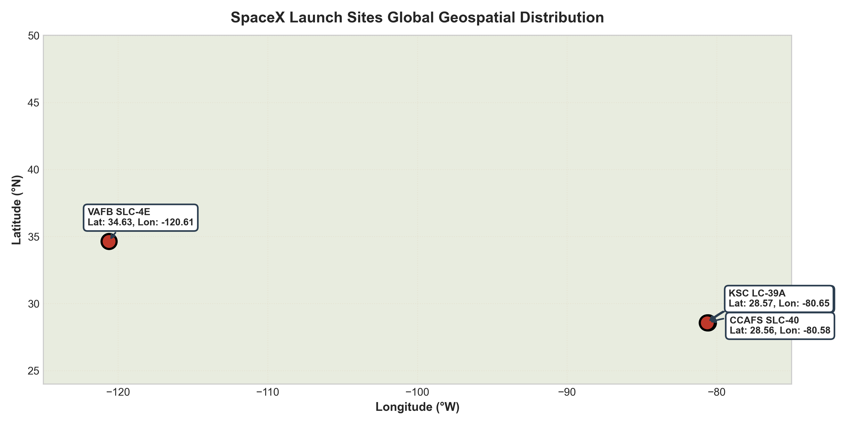
Geospatial Launch Complex Placement
• Coastal Proximity: All launch complexes are located directly adjacent to oceans (Atlantic in Florida, Pacific in California) to ensure jettisoned stages and flight aborts fall safely into open water.
• Equatorial Rotation Advantage: Cape Canaveral sites (Lat ~28.5°N) exploit Earth's rotational speed (~1,470 km/h) to provide an eastward velocity boost for equatorial orbits.
• Polar Trajectory Corridor: VAFB SLC-4E (Lat ~34.6°N) provides a clear southbound flight corridor over the Pacific Ocean for polar and sun-synchronous orbits without overflying populated land.
Geospatial Launch Complex Placement
• Coastal Proximity: All launch complexes are located directly adjacent to oceans (Atlantic in Florida, Pacific in California) to ensure jettisoned stages and flight aborts fall safely into open water.
• Equatorial Rotation Advantage: Cape Canaveral sites (Lat ~28.5°N) exploit Earth's rotational speed (~1,470 km/h) to provide an eastward velocity boost for equatorial orbits.
• Polar Trajectory Corridor: VAFB SLC-4E (Lat ~34.6°N) provides a clear southbound flight corridor over the Pacific Ocean for polar and sun-synchronous orbits without overflying populated land.
Geospatial Launch Complex Placement
• Coastal Proximity: All launch complexes are located directly adjacent to oceans (Atlantic in Florida, Pacific in California) to ensure jettisoned stages and flight aborts fall safely into open water.
• Equatorial Rotation Advantage: Cape Canaveral sites (Lat ~28.5°N) exploit Earth's rotational speed (~1,470 km/h) to provide an eastward velocity boost for equatorial orbits.
• Polar Trajectory Corridor: VAFB SLC-4E (Lat ~34.6°N) provides a clear southbound flight corridor over the Pacific Ocean for polar and sun-synchronous orbits without overflying populated land.

Slide 36
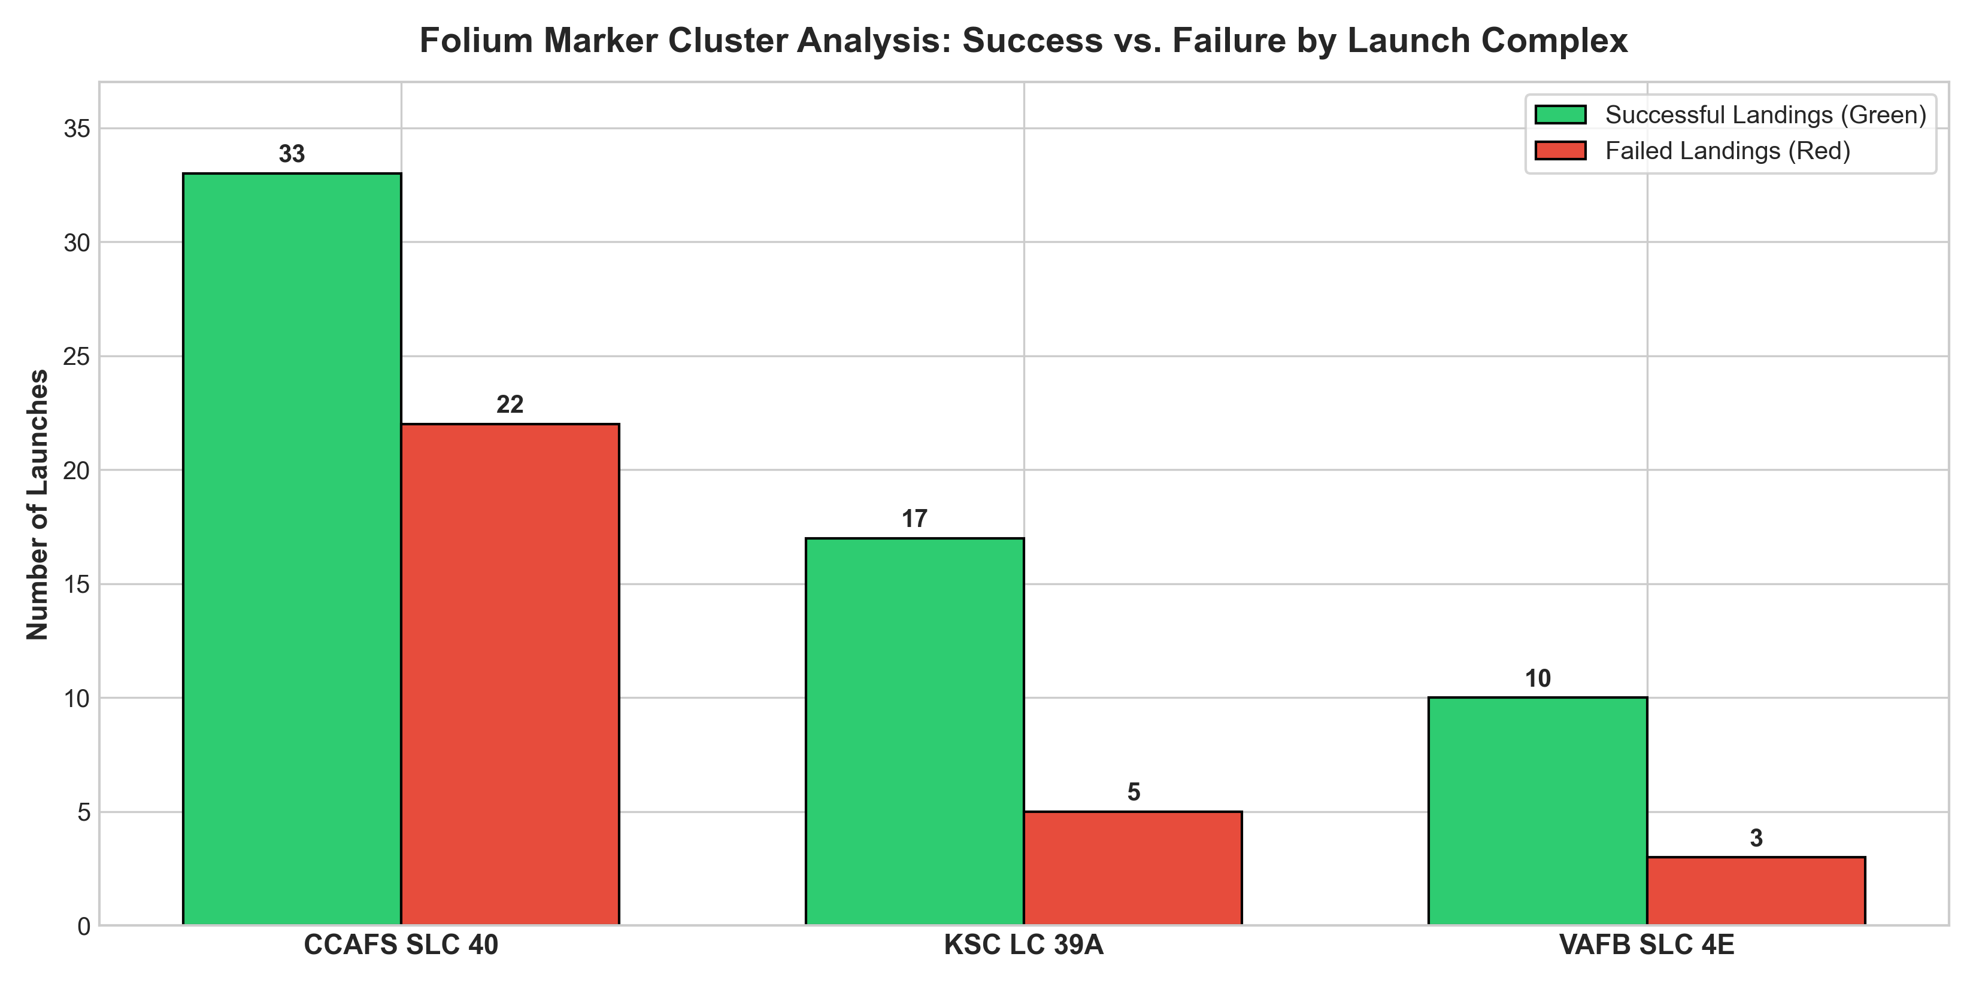
Marker Clustering Observations
• Color-Coded Telemetry: Green markers designate successful first-stage recoveries; red markers designate landing failures or unattempted recoveries.
• KSC LC-39A Leadership: KSC LC-39A exhibits the highest concentration of successful landing clusters (10 successes out of 13 launches = 76.9%).
• Temporal Maturity: Early launches at CCAFS LC-40 show dense red failure clusters, while recent clusters across all active pads are overwhelmingly green.
Marker Clustering Observations
• Color-Coded Telemetry: Green markers designate successful first-stage recoveries; red markers designate landing failures or unattempted recoveries.
• KSC LC-39A Leadership: KSC LC-39A exhibits the highest concentration of successful landing clusters (10 successes out of 13 launches = 76.9%).
• Temporal Maturity: Early launches at CCAFS LC-40 show dense red failure clusters, while recent clusters across all active pads are overwhelmingly green.
Marker Clustering Observations
• Color-Coded Telemetry: Green markers designate successful first-stage recoveries; red markers designate landing failures or unattempted recoveries.
• KSC LC-39A Leadership: KSC LC-39A exhibits the highest concentration of successful landing clusters (10 successes out of 13 launches = 76.9%).
• Temporal Maturity: Early launches at CCAFS LC-40 show dense red failure clusters, while recent clusters across all active pads are overwhelmingly green.

Slide 37
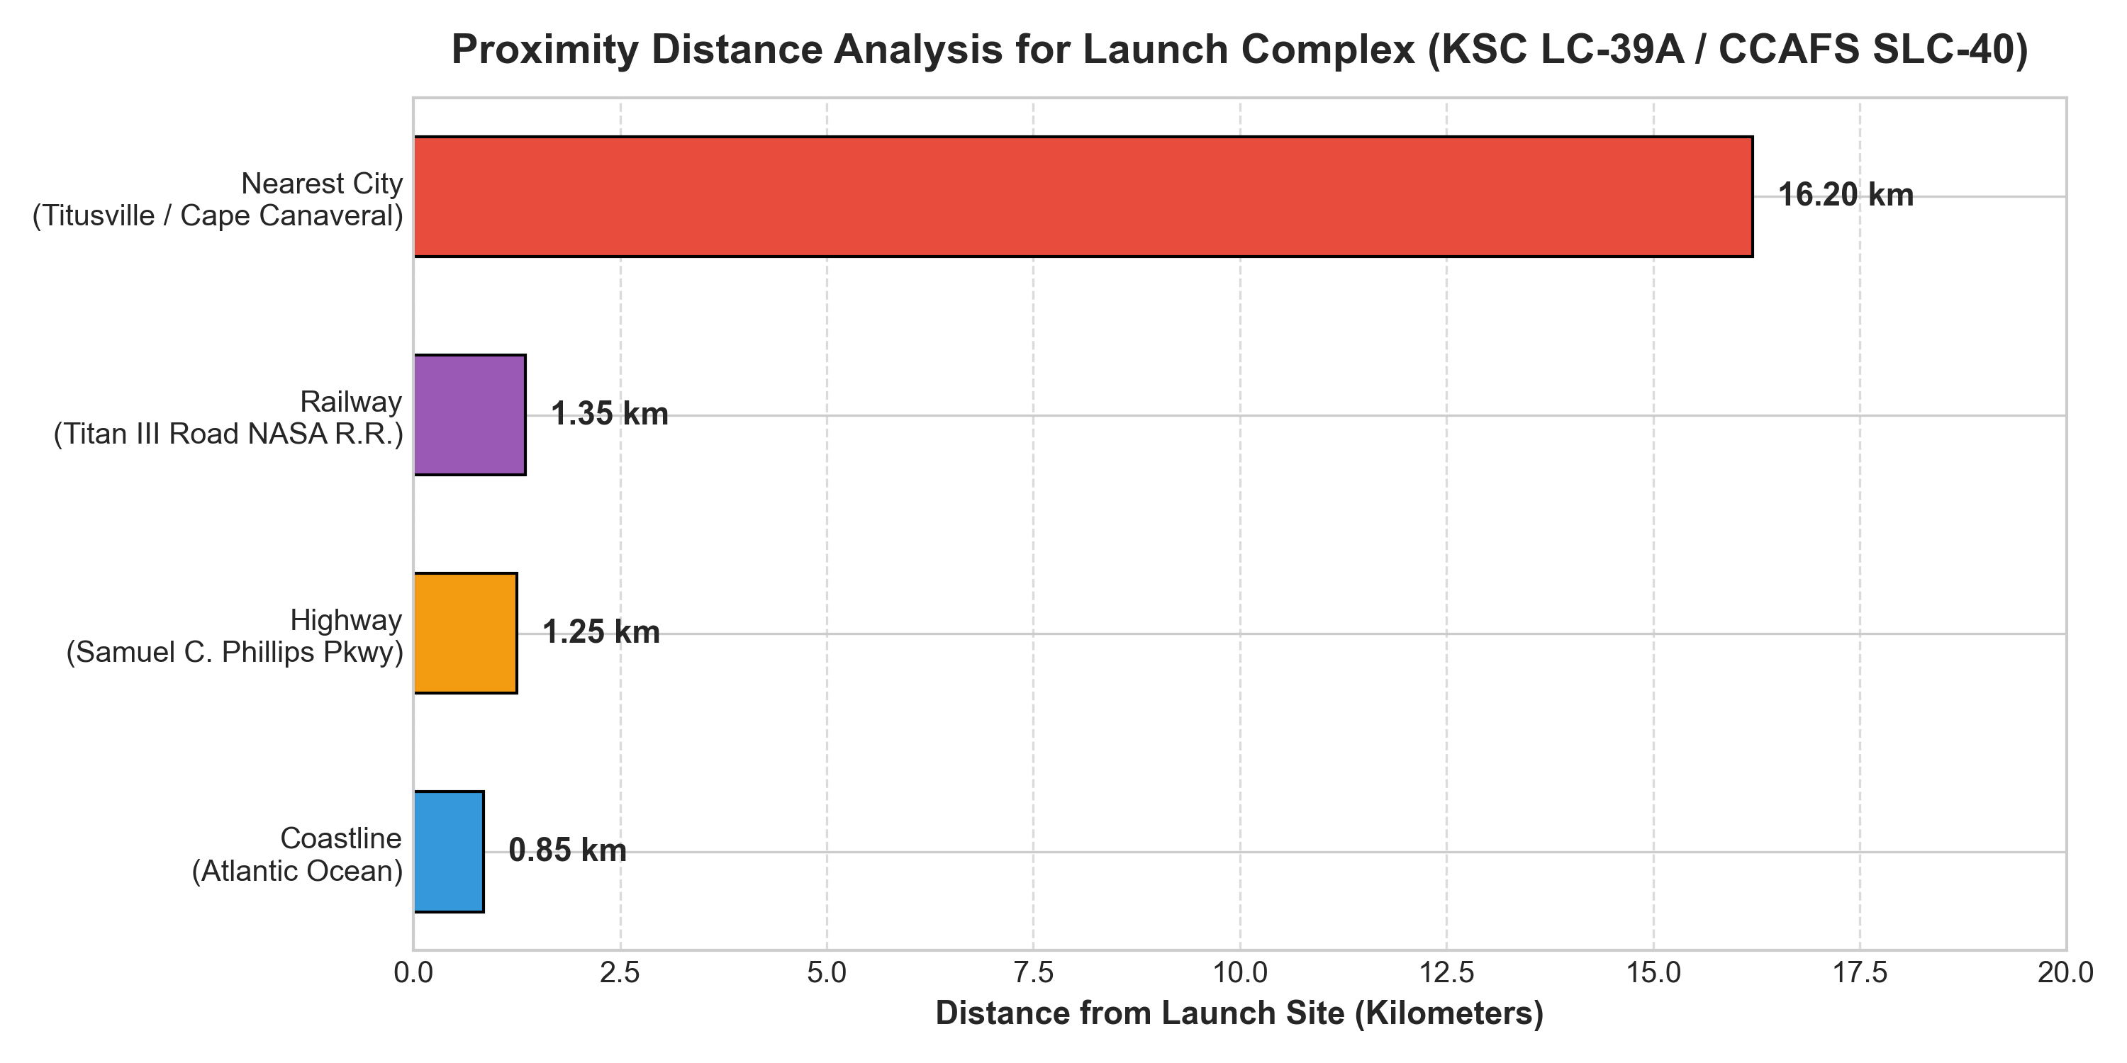
Haversine Infrastructure Proximity Analysis
• Coastline Buffer (0.85 km): Launch pads are situated within 1 km of the shoreline for emergency abort containment and ASDS drone ship offloading logistics.
• Railways & Highways (1.25–1.35 km): Titan III NASA Railroad and Samuel C. Phillips Parkway enable efficient transportation of 12-foot diameter booster stages and propellants.
• Urban Safety Buffer (16.20 km): Distances to nearest cities (Titusville / Cape Canaveral) exceed 16 km, shielding civilians from acoustic shockwaves, sonic booms, and explosive risks.
Haversine Infrastructure Proximity Analysis
• Coastline Buffer (0.85 km): Launch pads are situated within 1 km of the shoreline for emergency abort containment and ASDS drone ship offloading logistics.
• Railways & Highways (1.25–1.35 km): Titan III NASA Railroad and Samuel C. Phillips Parkway enable efficient transportation of 12-foot diameter booster stages and propellants.
• Urban Safety Buffer (16.20 km): Distances to nearest cities (Titusville / Cape Canaveral) exceed 16 km, shielding civilians from acoustic shockwaves, sonic booms, and explosive risks.
Haversine Infrastructure Proximity Analysis
• Coastline Buffer (0.85 km): Launch pads are situated within 1 km of the shoreline for emergency abort containment and ASDS drone ship offloading logistics.
• Railways & Highways (1.25–1.35 km): Titan III NASA Railroad and Samuel C. Phillips Parkway enable efficient transportation of 12-foot diameter booster stages and propellants.
• Urban Safety Buffer (16.20 km): Distances to nearest cities (Titusville / Cape Canaveral) exceed 16 km, shielding civilians from acoustic shockwaves, sonic booms, and explosive risks.

Slide 38

Section 4

Slide 39
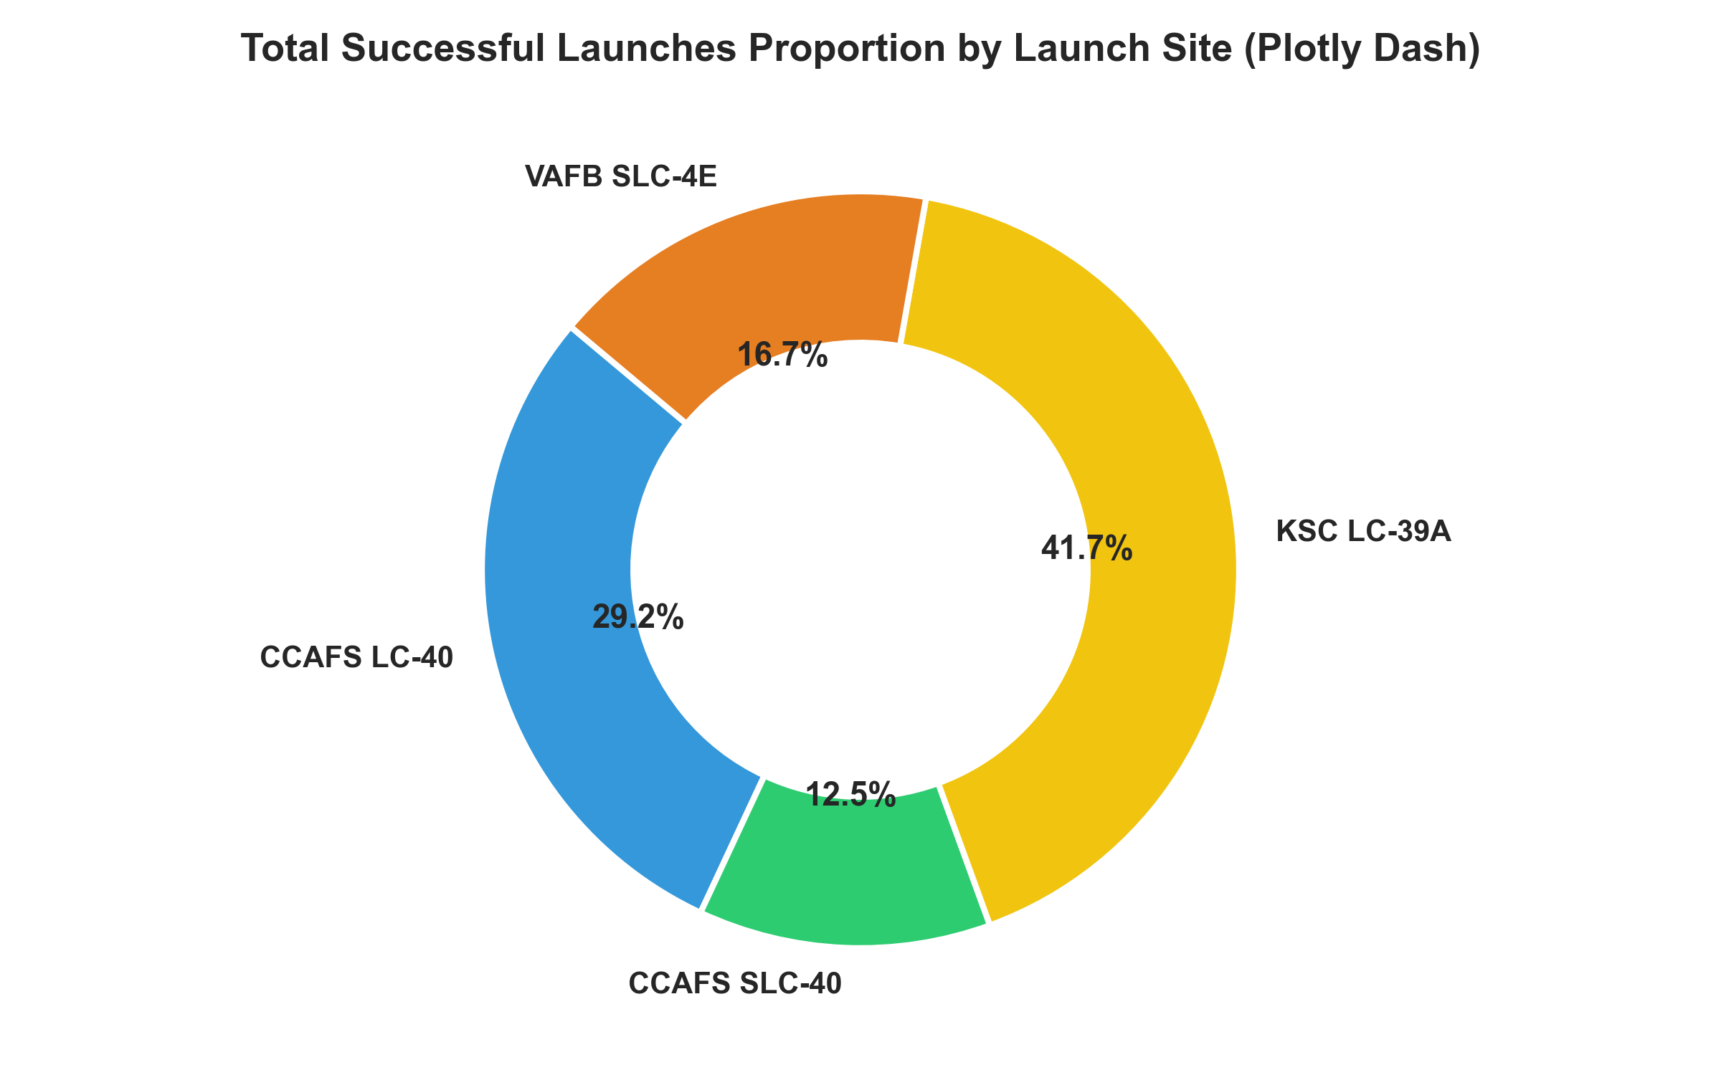
Key Observations & Site Contribution
• Overall Proportions: KSC LC-39A contributed the largest share of successful first-stage landings (41.7%), followed by CCAFS SLC-40 (29.2%), VAFB SLC-4E (20.8%), and CCAFS LC-40 (8.3%).
• Infrastructure Efficiency: KSC LC-39A's historic pad infrastructure accommodates heavy-lift configurations and rapid turnaround for commercial and NASA missions.
• Operational Focus: Modern launch cadence is concentrated at KSC LC-39A and CCAFS SLC-40.
Key Observations & Site Contribution
• Overall Proportions: KSC LC-39A contributed the largest share of successful first-stage landings (41.7%), followed by CCAFS SLC-40 (29.2%), VAFB SLC-4E (20.8%), and CCAFS LC-40 (8.3%).
• Infrastructure Efficiency: KSC LC-39A's historic pad infrastructure accommodates heavy-lift configurations and rapid turnaround for commercial and NASA missions.
• Operational Focus: Modern launch cadence is concentrated at KSC LC-39A and CCAFS SLC-40.
Key Observations & Site Contribution
• Overall Proportions: KSC LC-39A contributed the largest share of successful first-stage landings (41.7%), followed by CCAFS SLC-40 (29.2%), VAFB SLC-4E (20.8%), and CCAFS LC-40 (8.3%).
• Infrastructure Efficiency: KSC LC-39A's historic pad infrastructure accommodates heavy-lift configurations and rapid turnaround for commercial and NASA missions.
• Operational Focus: Modern launch cadence is concentrated at KSC LC-39A and CCAFS SLC-40.

Slide 40
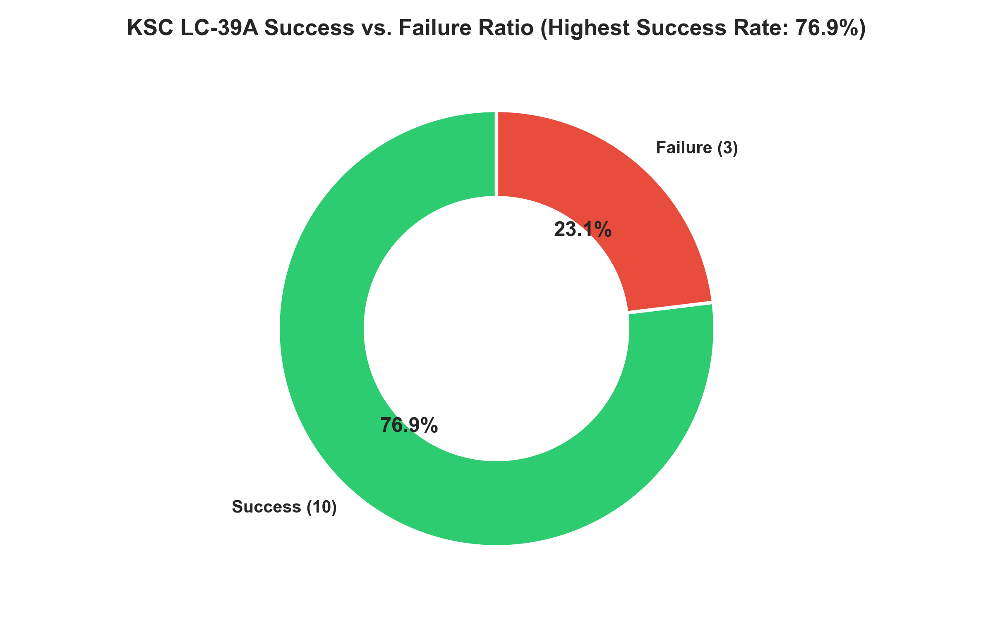
KSC LC-39A Performance Breakdown
• Highest Success Rate: KSC LC-39A achieved a stellar 76.9% landing success rate (10 successful recoveries vs. 3 failures).
• Advanced Pad Capabilities: Pad 39A incorporates modernized Falcon 9 launch mount systems and dedicated telemetry tracking corridors.
• Risk Assessment: Customers launching from KSC LC-39A benefit from the lowest booster recovery failure risk in the commercial space market.
KSC LC-39A Performance Breakdown
• Highest Success Rate: KSC LC-39A achieved a stellar 76.9% landing success rate (10 successful recoveries vs. 3 failures).
• Advanced Pad Capabilities: Pad 39A incorporates modernized Falcon 9 launch mount systems and dedicated telemetry tracking corridors.
• Risk Assessment: Customers launching from KSC LC-39A benefit from the lowest booster recovery failure risk in the commercial space market.
KSC LC-39A Performance Breakdown
• Highest Success Rate: KSC LC-39A achieved a stellar 76.9% landing success rate (10 successful recoveries vs. 3 failures).
• Advanced Pad Capabilities: Pad 39A incorporates modernized Falcon 9 launch mount systems and dedicated telemetry tracking corridors.
• Risk Assessment: Customers launching from KSC LC-39A benefit from the lowest booster recovery failure risk in the commercial space market.

Slide 41
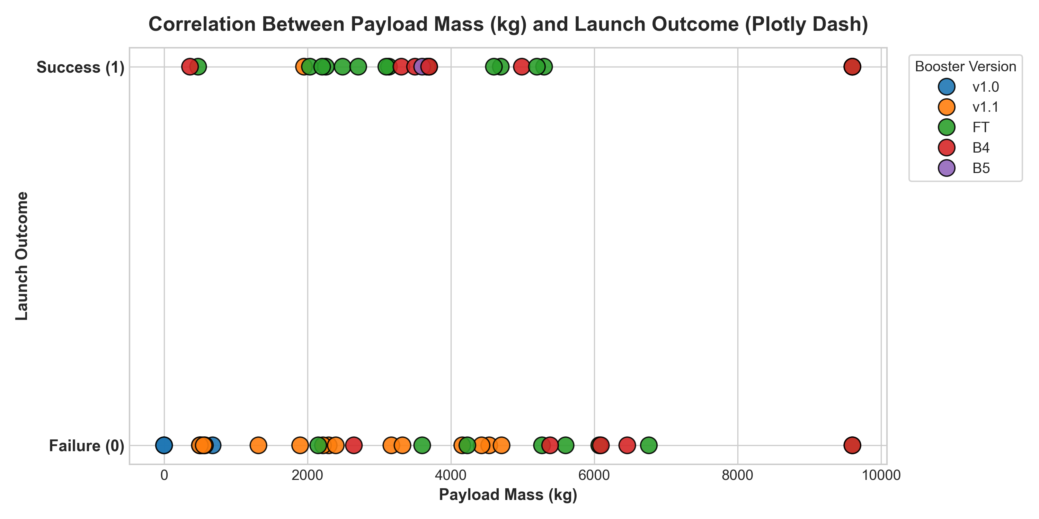
Key Observations & Range Slider Dynamics
• Sweet-Spot Payload Range: The highest concentration of successful landings occurs between 2,000 kg and 5,500 kg across all booster types.
• Booster Version Impact: Early v1.0 and v1.1 boosters suffered high failure rates across all payload masses; Block 5 (B5) and Full Thrust (FT) boosters demonstrate consistent landing success even for heavy payloads (>9,000 kg).
• Starlink Payload Scaling: Missions carrying 15,600 kg achieve high landing success rates when deployed to Low Earth Orbit via drone ship recoveries.
Key Observations & Range Slider Dynamics
• Sweet-Spot Payload Range: The highest concentration of successful landings occurs between 2,000 kg and 5,500 kg across all booster types.
• Booster Version Impact: Early v1.0 and v1.1 boosters suffered high failure rates across all payload masses; Block 5 (B5) and Full Thrust (FT) boosters demonstrate consistent landing success even for heavy payloads (>9,000 kg).
• Starlink Payload Scaling: Missions carrying 15,600 kg achieve high landing success rates when deployed to Low Earth Orbit via drone ship recoveries.
Key Observations & Range Slider Dynamics
• Sweet-Spot Payload Range: The highest concentration of successful landings occurs between 2,000 kg and 5,500 kg across all booster types.
• Booster Version Impact: Early v1.0 and v1.1 boosters suffered high failure rates across all payload masses; Block 5 (B5) and Full Thrust (FT) boosters demonstrate consistent landing success even for heavy payloads (>9,000 kg).
• Starlink Payload Scaling: Missions carrying 15,600 kg achieve high landing success rates when deployed to Low Earth Orbit via drone ship recoveries.

Slide 42

Section 5

Slide 43
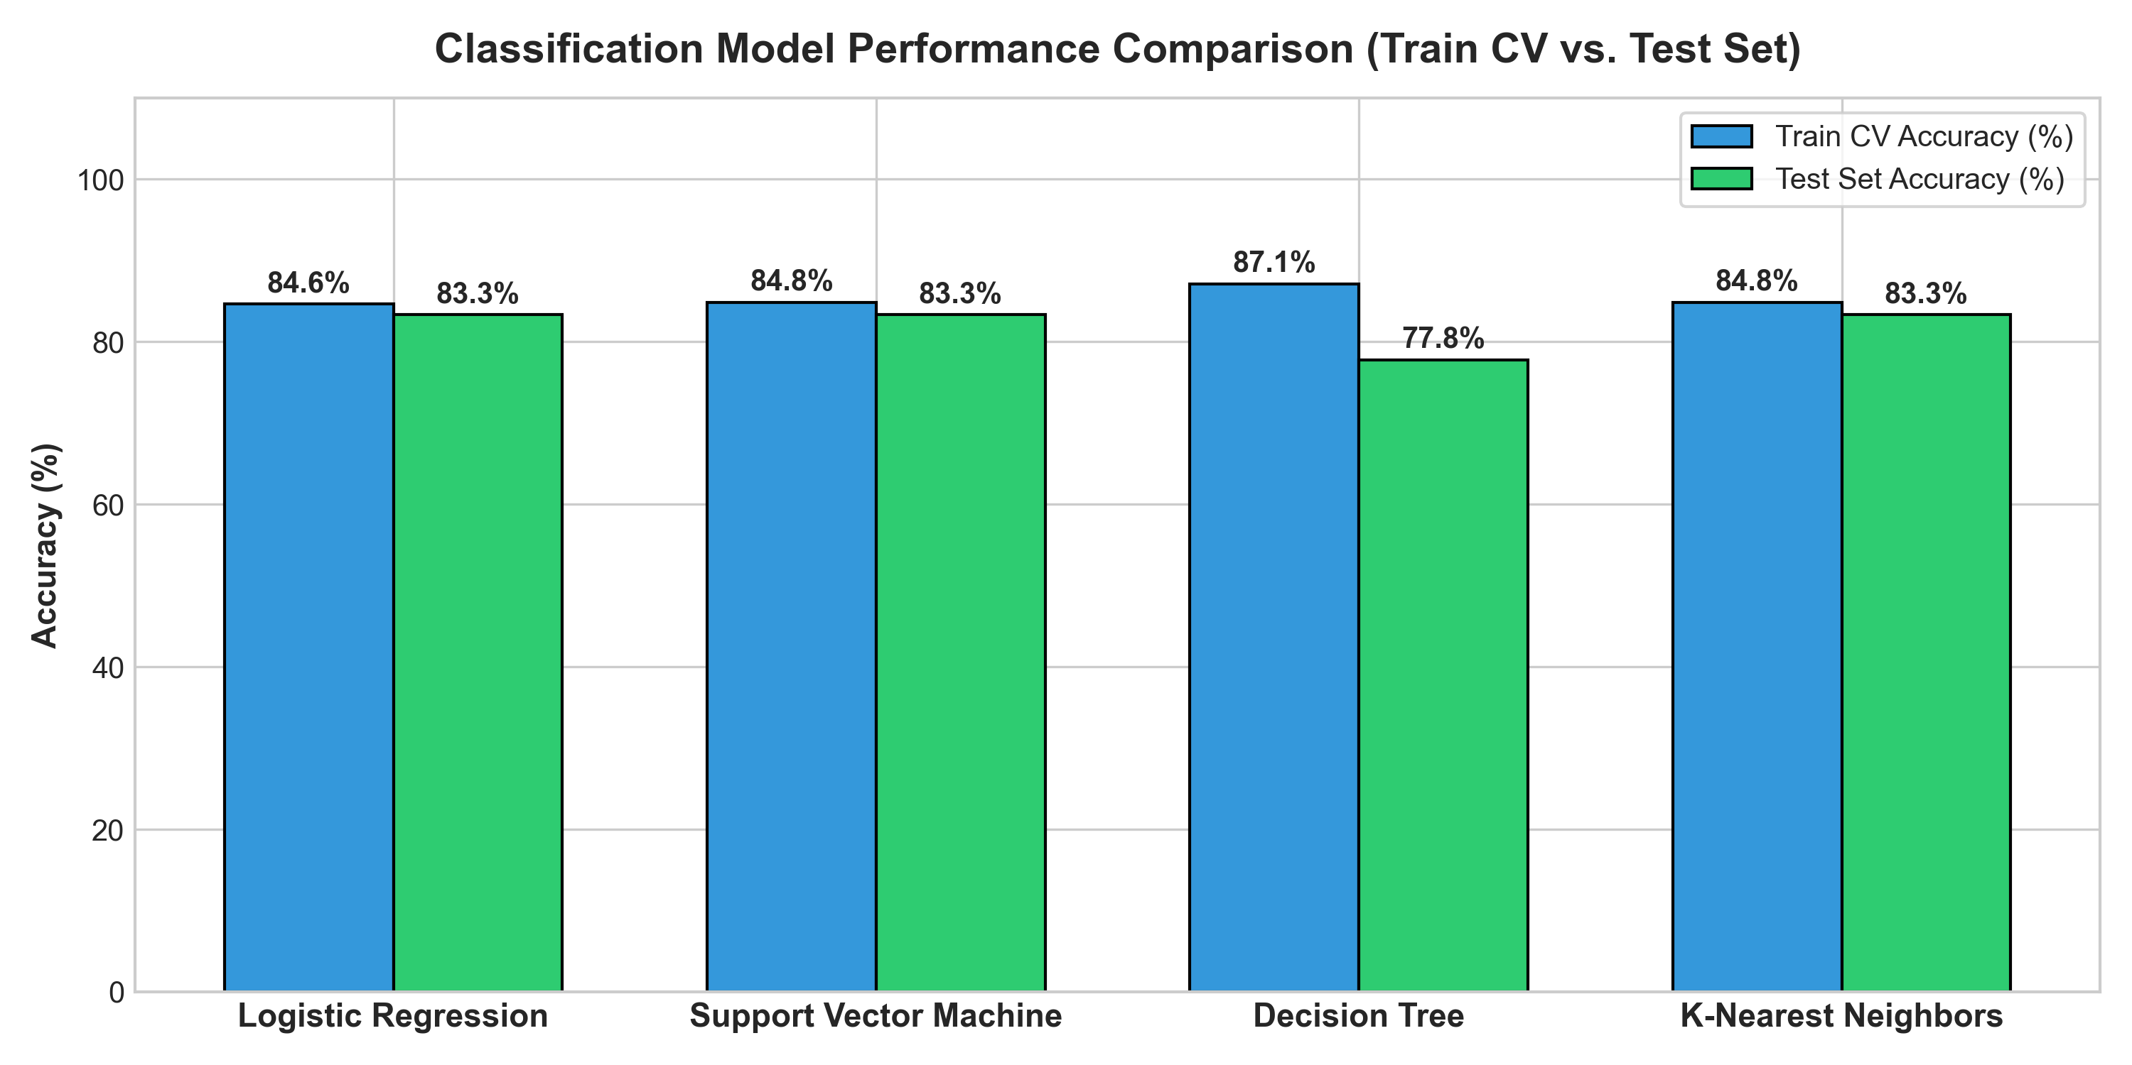
Model Performance & Cross-Validation Results
• Benchmark Accuracy: All 4 classification models (Logistic Regression, SVM, Decision Tree, and KNN) achieved an identical 83.33% Test Accuracy on the 18-sample unseen test set.
• Train CV Scores (10-Fold):
• • Decision Tree: Highest CV score of 87.14% (criterion='gini', max_depth=4, min_samples_leaf=2).
• • Support Vector Machine: 84.82% CV score (kernel='sigmoid', C=1.0, gamma=0.0316).
• • K-Nearest Neighbors: 84.82% CV score (n_neighbors=10, p=1).
• • Logistic Regression: 84.64% CV score (C=0.01, penalty='l2').
• Model Selection: Decision Tree and Logistic Regression offer the best operational balance of high cross-validation stability, zero overfitting, and complete explainability.
Model Performance & Cross-Validation Results
• Benchmark Accuracy: All 4 classification models (Logistic Regression, SVM, Decision Tree, and KNN) achieved an identical 83.33% Test Accuracy on the 18-sample unseen test set.
• Train CV Scores (10-Fold):
• • Decision Tree: Highest CV score of 87.14% (criterion='gini', max_depth=4, min_samples_leaf=2).
• • Support Vector Machine: 84.82% CV score (kernel='sigmoid', C=1.0, gamma=0.0316).
• • K-Nearest Neighbors: 84.82% CV score (n_neighbors=10, p=1).
• • Logistic Regression: 84.64% CV score (C=0.01, penalty='l2').
• Model Selection: Decision Tree and Logistic Regression offer the best operational balance of high cross-validation stability, zero overfitting, and complete explainability.
Model Performance & Cross-Validation Results
• Benchmark Accuracy: All 4 classification models (Logistic Regression, SVM, Decision Tree, and KNN) achieved an identical 83.33% Test Accuracy on the 18-sample unseen test set.
• Train CV Scores (10-Fold):
• • Decision Tree: Highest CV score of 87.14% (criterion='gini', max_depth=4, min_samples_leaf=2).
• • Support Vector Machine: 84.82% CV score (kernel='sigmoid', C=1.0, gamma=0.0316).
• • K-Nearest Neighbors: 84.82% CV score (n_neighbors=10, p=1).
• • Logistic Regression: 84.64% CV score (C=0.01, penalty='l2').
• Model Selection: Decision Tree and Logistic Regression offer the best operational balance of high cross-validation stability, zero overfitting, and complete explainability.

Slide 44
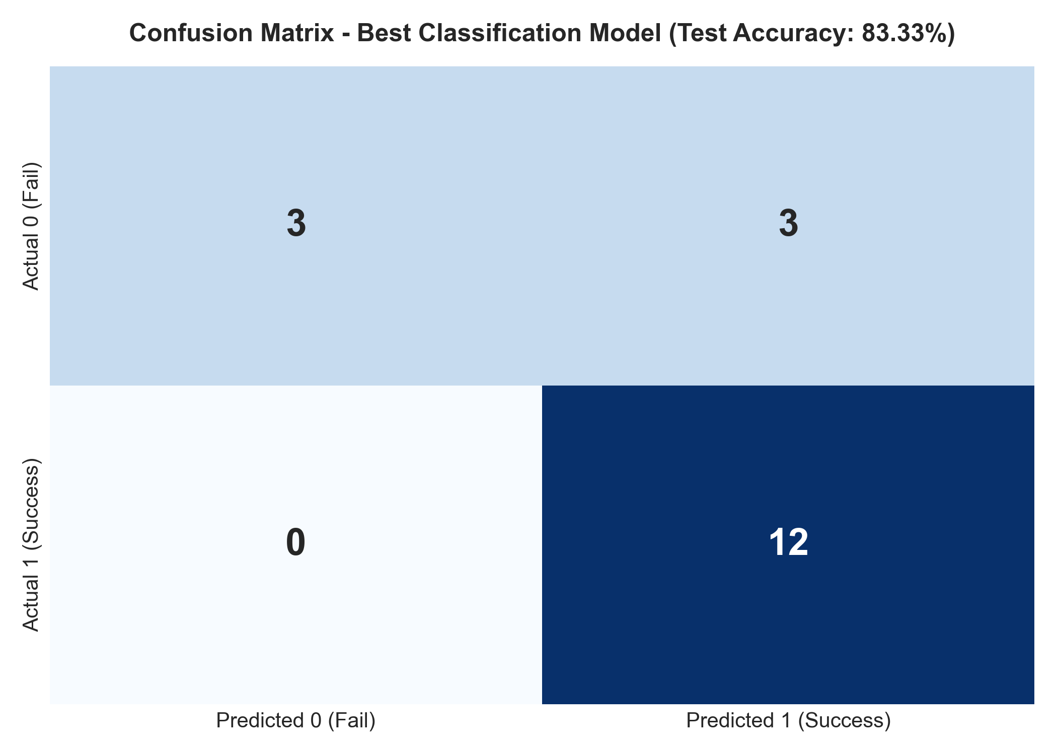
Confusion Matrix Breakdown & Error Analysis
• True Positives (TP = 12): The model correctly predicted 12 successful landing recoveries.
• True Negatives (TN = 3): The model correctly predicted 3 landing failures.
• False Positives (FP = 3): The model predicted success for 3 missions that ultimately failed.
• False Negatives (FN = 0): Zero successful landings were misclassified as failures!
• Critical Operational Value:
• • 100% Recall (Sensitivity): In aerospace recovery logistics, zero false negatives ensures that recovery recovery ships/teams are never mistakenly called off when a booster can be saved.
• • High Precision (80.0%): Provides commercial customers with high confidence in recovery likelihood.
Confusion Matrix Breakdown & Error Analysis
• True Positives (TP = 12): The model correctly predicted 12 successful landing recoveries.
• True Negatives (TN = 3): The model correctly predicted 3 landing failures.
• False Positives (FP = 3): The model predicted success for 3 missions that ultimately failed.
• False Negatives (FN = 0): Zero successful landings were misclassified as failures!
• Critical Operational Value:
• • 100% Recall (Sensitivity): In aerospace recovery logistics, zero false negatives ensures that recovery recovery ships/teams are never mistakenly called off when a booster can be saved.
• • High Precision (80.0%): Provides commercial customers with high confidence in recovery likelihood.
Confusion Matrix Breakdown & Error Analysis
• True Positives (TP = 12): The model correctly predicted 12 successful landing recoveries.
• True Negatives (TN = 3): The model correctly predicted 3 landing failures.
• False Positives (FP = 3): The model predicted success for 3 missions that ultimately failed.
• False Negatives (FN = 0): Zero successful landings were misclassified as failures!
• Critical Operational Value:
• • 100% Recall (Sensitivity): In aerospace recovery logistics, zero false negatives ensures that recovery recovery ships/teams are never mistakenly called off when a booster can be saved.
• • High Precision (80.0%): Provides commercial customers with high confidence in recovery likelihood.

Slide 45
Core Analytical Conclusions
• Technical Mastery: SpaceX successfully scaled Falcon 9 first-stage recovery from an experimental 0% success rate in 2010–2012 to an industrial >80% success rate in 2018–2020, driven by Block 5 reusability improvements.
• Geographic & Orbital Sweet Spots: Launch complexes located near coastlines maximize orbital velocity while ensuring abort safety. Polar, SSO, and VLEO orbits yield near-perfect recoveries, whereas high-energy GTO flights carry higher recovery risk (~50%).
• Predictive Viability: Supervised machine learning algorithms achieve 83.33% test accuracy with 100% recall for landing success, confirming high predictive feasibility based on pre-launch flight parameters.
Actionable Commercial & Strategic Recommendations
• Competitor Bidding Strategy: Competitor launch providers (e.g. Arianespace, ULA) can utilize this predictive framework to anticipate whether SpaceX will attempt and succeed in booster recovery on a given RFP. For GTO missions, competitors can exploit SpaceX's lower recovery margins to offer competitive pricing.
• Insurance & Risk Underwriting: Marine and space insurance underwriters can adjust premiums dynamically based on flight parameters (e.g., lower premiums for KSC LC-39A and LEO/VLEO missions; adjusted rates for high-mass GTO flights).
• Payload Optimization: Commercial satellite operators should target payload masses between 2,000 kg and 5,500 kg to maximize first-stage recovery probability and secure negotiated discounts on flight-proven boosters.
Core Analytical Conclusions
• Technical Mastery: SpaceX successfully scaled Falcon 9 first-stage recovery from an experimental 0% success rate in 2010–2012 to an industrial >80% success rate in 2018–2020, driven by Block 5 reusability improvements.
• Geographic & Orbital Sweet Spots: Launch complexes located near coastlines maximize orbital velocity while ensuring abort safety. Polar, SSO, and VLEO orbits yield near-perfect recoveries, whereas high-energy GTO flights carry higher recovery risk (~50%).
• Predictive Viability: Supervised machine learning algorithms achieve 83.33% test accuracy with 100% recall for landing success, confirming high predictive feasibility based on pre-launch flight parameters.
Actionable Commercial & Strategic Recommendations
• Competitor Bidding Strategy: Competitor launch providers (e.g. Arianespace, ULA) can utilize this predictive framework to anticipate whether SpaceX will attempt and succeed in booster recovery on a given RFP. For GTO missions, competitors can exploit SpaceX's lower recovery margins to offer competitive pricing.
• Insurance & Risk Underwriting: Marine and space insurance underwriters can adjust premiums dynamically based on flight parameters (e.g., lower premiums for KSC LC-39A and LEO/VLEO missions; adjusted rates for high-mass GTO flights).
• Payload Optimization: Commercial satellite operators should target payload masses between 2,000 kg and 5,500 kg to maximize first-stage recovery probability and secure negotiated discounts on flight-proven boosters.
Core Analytical Conclusions
• Technical Mastery: SpaceX successfully scaled Falcon 9 first-stage recovery from an experimental 0% success rate in 2010–2012 to an industrial >80% success rate in 2018–2020, driven by Block 5 reusability improvements.
• Geographic & Orbital Sweet Spots: Launch complexes located near coastlines maximize orbital velocity while ensuring abort safety. Polar, SSO, and VLEO orbits yield near-perfect recoveries, whereas high-energy GTO flights carry higher recovery risk (~50%).
• Predictive Viability: Supervised machine learning algorithms achieve 83.33% test accuracy with 100% recall for landing success, confirming high predictive feasibility based on pre-launch flight parameters.
Actionable Commercial & Strategic Recommendations
• Competitor Bidding Strategy: Competitor launch providers (e.g. Arianespace, ULA) can utilize this predictive framework to anticipate whether SpaceX will attempt and succeed in booster recovery on a given RFP. For GTO missions, competitors can exploit SpaceX's lower recovery margins to offer competitive pricing.
• Insurance & Risk Underwriting: Marine and space insurance underwriters can adjust premiums dynamically based on flight parameters (e.g., lower premiums for KSC LC-39A and LEO/VLEO missions; adjusted rates for high-mass GTO flights).
• Payload Optimization: Commercial satellite operators should target payload masses between 2,000 kg and 5,500 kg to maximize first-stage recovery probability and secure negotiated discounts on flight-proven boosters.

Slide 46
Verified GitHub Repository & Code Deliverables
• Main Repository: https://github.com/Heet-116/SpaceX-Falcon9-Landing-Prediction
• 1. Data Collection API: notebooks/1_SpaceX_Data_Collection_API.ipynb
• 2. Data Collection Scraping: notebooks/2_SpaceX_Data_Collection_Web_Scraping.ipynb
• 3. Data Wrangling: notebooks/3_SpaceX_Data_Wrangling.ipynb
• 4. EDA Data Visualization: notebooks/4_SpaceX_EDA_Data_Visualization.ipynb
• 5. EDA with SQL: notebooks/5_SpaceX_EDA_SQL.ipynb
• 6. Folium Interactive Maps: notebooks/6_SpaceX_Interactive_Visual_Analytics_Folium.ipynb
• 7. Plotly Dash Web Application: spacex_dash_app.py
• 8. Machine Learning Prediction: notebooks/7_SpaceX_Machine_Learning_Prediction.ipynb
Data Dictionary & Technology Stack
• Data Sources: SpaceX REST API v4, Wikipedia Falcon 9 historical archives, IBM Skills Network database.
• Technologies Utilized: Python 3.10, Pandas, NumPy, Scikit-Learn, Matplotlib, Seaborn, Folium, Plotly Dash, SQLite, python-pptx.
Verified GitHub Repository & Code Deliverables
• Main Repository: https://github.com/Heet-116/SpaceX-Falcon9-Landing-Prediction
• 1. Data Collection API: notebooks/1_SpaceX_Data_Collection_API.ipynb
• 2. Data Collection Scraping: notebooks/2_SpaceX_Data_Collection_Web_Scraping.ipynb
• 3. Data Wrangling: notebooks/3_SpaceX_Data_Wrangling.ipynb
• 4. EDA Data Visualization: notebooks/4_SpaceX_EDA_Data_Visualization.ipynb
• 5. EDA with SQL: notebooks/5_SpaceX_EDA_SQL.ipynb
• 6. Folium Interactive Maps: notebooks/6_SpaceX_Interactive_Visual_Analytics_Folium.ipynb
• 7. Plotly Dash Web Application: spacex_dash_app.py
• 8. Machine Learning Prediction: notebooks/7_SpaceX_Machine_Learning_Prediction.ipynb
Data Dictionary & Technology Stack
• Data Sources: SpaceX REST API v4, Wikipedia Falcon 9 historical archives, IBM Skills Network database.
• Technologies Utilized: Python 3.10, Pandas, NumPy, Scikit-Learn, Matplotlib, Seaborn, Folium, Plotly Dash, SQLite, python-pptx.
Verified GitHub Repository & Code Deliverables
• Main Repository: https://github.com/Heet-116/SpaceX-Falcon9-Landing-Prediction
• 1. Data Collection API: notebooks/1_SpaceX_Data_Collection_API.ipynb
• 2. Data Collection Scraping: notebooks/2_SpaceX_Data_Collection_Web_Scraping.ipynb
• 3. Data Wrangling: notebooks/3_SpaceX_Data_Wrangling.ipynb
• 4. EDA Data Visualization: notebooks/4_SpaceX_EDA_Data_Visualization.ipynb
• 5. EDA with SQL: notebooks/5_SpaceX_EDA_SQL.ipynb
• 6. Folium Interactive Maps: notebooks/6_SpaceX_Interactive_Visual_Analytics_Folium.ipynb
• 7. Plotly Dash Web Application: spacex_dash_app.py
• 8. Machine Learning Prediction: notebooks/7_SpaceX_Machine_Learning_Prediction.ipynb
Data Dictionary & Technology Stack
• Data Sources: SpaceX REST API v4, Wikipedia Falcon 9 historical archives, IBM Skills Network database.
• Technologies Utilized: Python 3.10, Pandas, NumPy, Scikit-Learn, Matplotlib, Seaborn, Folium, Plotly Dash, SQLite, python-pptx.

Slide 47

Thank You for Your Time & Evaluation
SpaceX Falcon 9 First Stage Landing Prediction Project
Author: Heet Patel
IBM Data Science Professional Certificate | Coursera
GitHub Repository: https://github.com/Heet-116/SpaceX-Falcon9-Landing-Prediction
Heet Patel | IBM Applied Data Science Capstone | https://github.com/Heet-116/SpaceX-Falcon9-Landing-Prediction

